Slide 1
Waterborne Primers: Providing the Base for Exceptional Topcoat Performance
Jocelyn Gruver and Paul Doll
PNWSCT, October 2018
®™ Trademark of The Dow Chemical Company ("Dow") or an affiliated company of Dow

Slide 2
Outline of Talk
Introduction/Background
Stainblocking and Locking Mechanisms
Next Generation Primer Stainblocking Performance
Exterior Primer Performance
Summary

Slide 3

Primer Background
Two main functions of a primer
  Enhance the ability of a topcoat to beautify the substrate
  Add durability to extend the life of the topcoat
Critical performance needs
  Reduce stains from migrating through the topcoat
  Hiding topographic variations
  Sealing porous substrates
  Preventing old colors from showing through the topcoat
  Blocking persistent odors
  Adhesion to a wide variety of substrates
  Excellent exterior durability

Slide 4
Primer Segmentation
Each major manufacturer has at least 10 primer product lines
Specific functionality targets and markets
  Fast Drying
  Multipurpose
  Mold Killing
  Low Odor
  Stainblocking
Very few new developments in recent years other than transition from solvent-borne to waterborne technology
In CARB report R. Fernando Found that “solvent based coatings perform significantly better than waterborne coatings” [for stain blocking]*
* www.arb.ca.gov/coatings/arch/spsu_final_report_may_2012.pdf

Slide 5
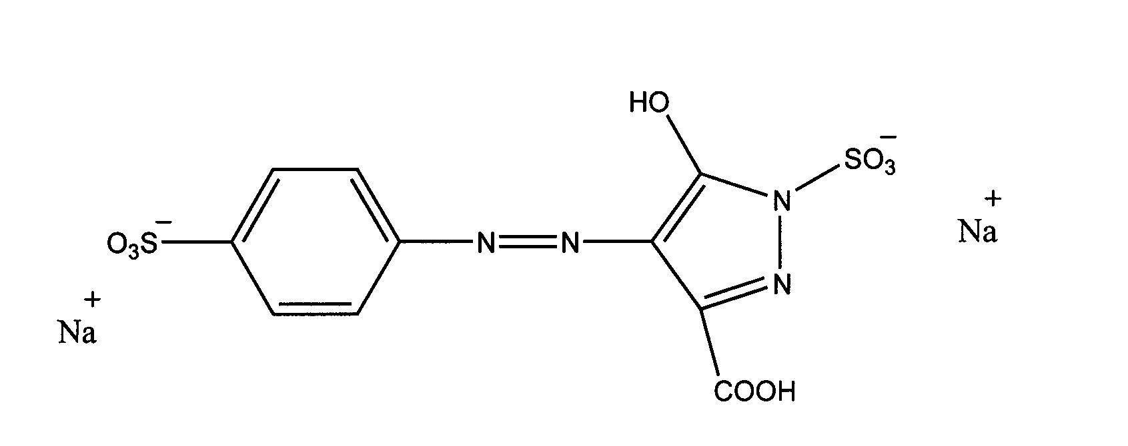
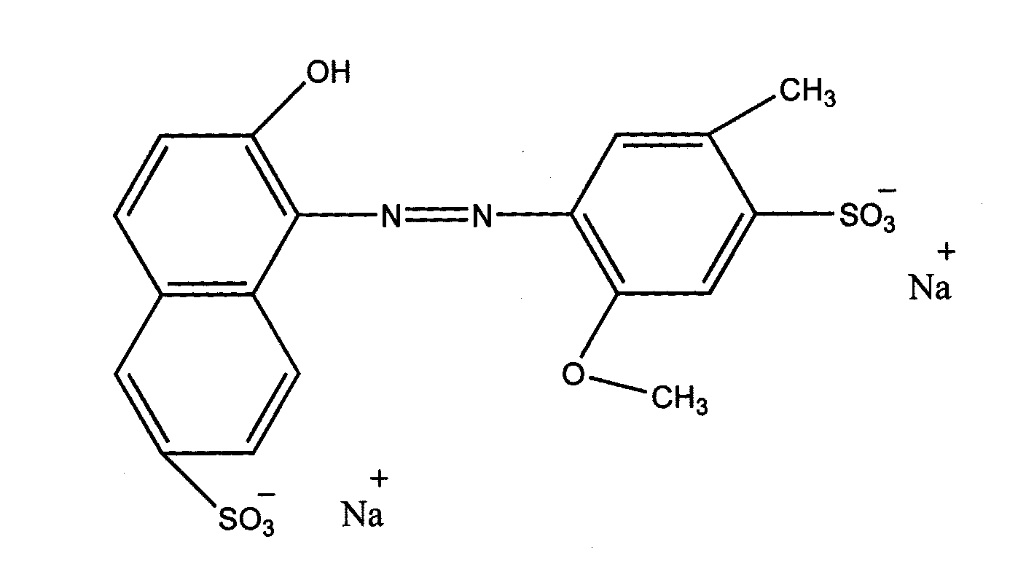
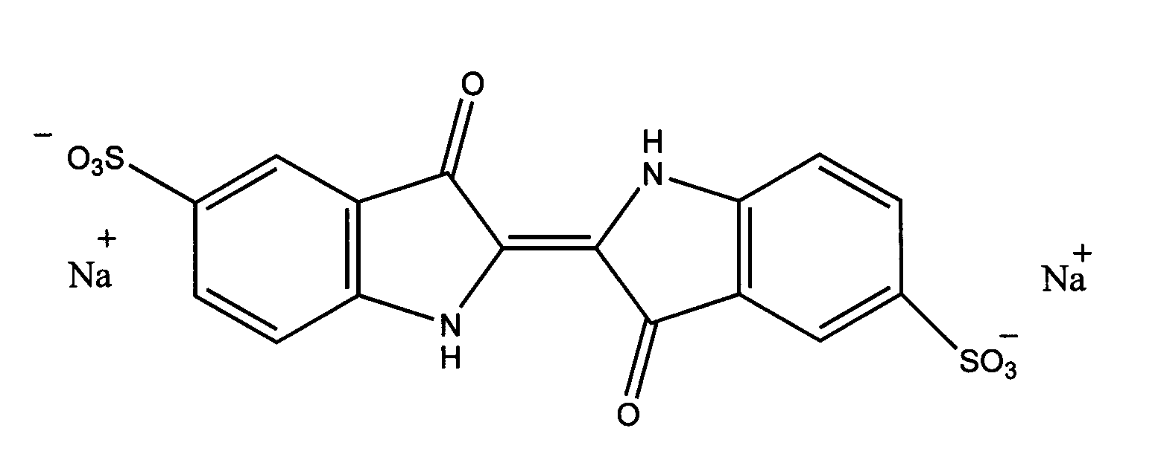
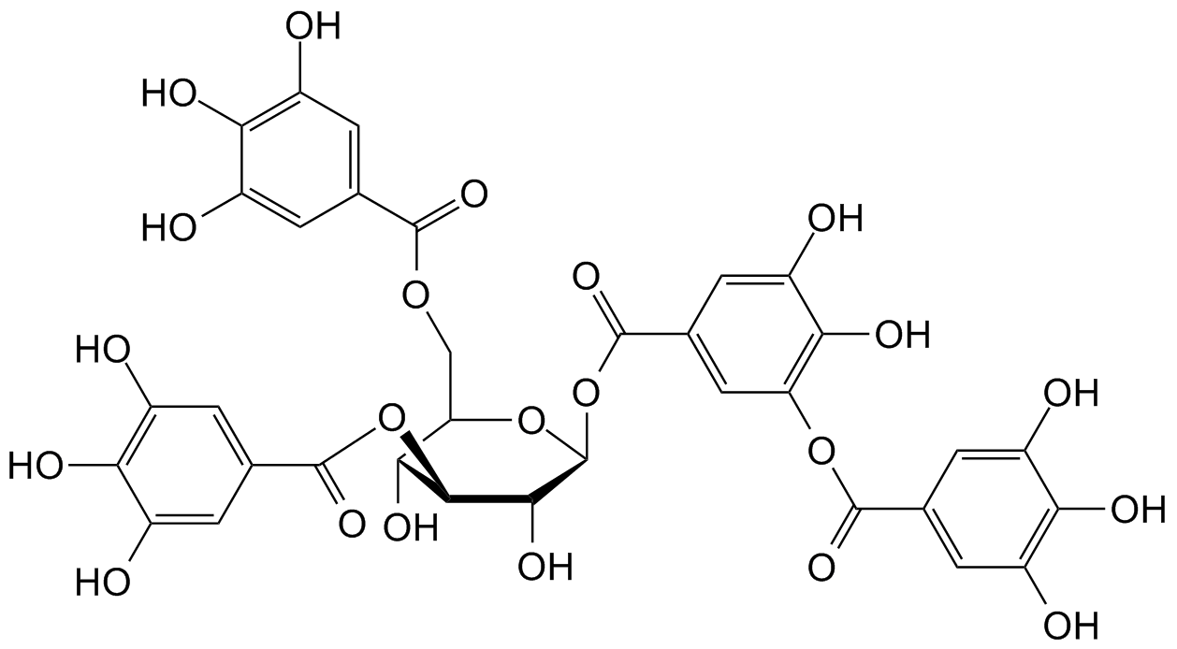
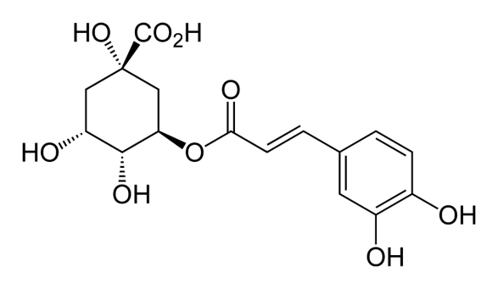
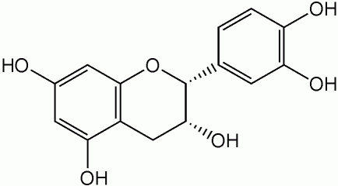
Typical Problematic Stains
Representative Food and Ink Colorants
FD&C Yellow #5
FD&C Red #40
FD&C Blue #2
Some Representative Tannins
Chlorogenic Acid
Epicatechin
Tannic Acid

Slide 6
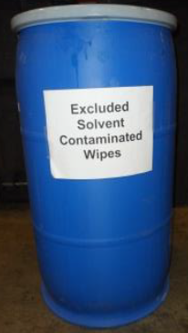
Solvent-borne Technology
Key Features
Soluble resin
  i.e., Shellac, Alkyd, Styrene Acrylic
Low Cost
Excellent hiding of hydrophilic stains
High VOC and odor
Messy to clean-up (use of flammable solvents)
Stain Blocking Mechanism
Hydrophilic water-based stains are insoluble in the hydrophobic wet film
Blocks stain at substrate/primer interface
One coat stain blocking with stain hiding capable
Still the best technology for very heavy stains
www.epa.gov/.../solvents/solvent_wipes_webnr_052214.pdf

Slide 7

Waterborne Technology
Key Features
Dispersed latex resin in water
  All-Acrylic, Styrene Acrylic, Modified Alkyds, Epoxy Esters
Easier clean-up
Low VOC & odor possible
Better exterior durability
Stain Locking Mechanism
Hydrophilic water-based stains are solubilized in the hydrophilic wet film
Locks stains in dry primer film
  Primer does not hide stain
May need two coats for stain blocking
Blocks at primer topcoat interface
Functional pigments are typically required in the formulation
http://visibleearth.nasa.gov/
7

Slide 8
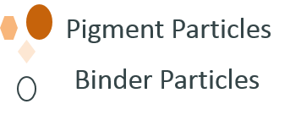

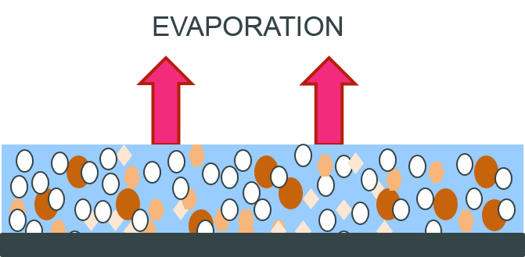

Waterborne Emulsion Film Formation
Emulsion particles must coalesce
More channels through the film
High PVC can interfere with this process
Stainblocking and locking is more difficult

Slide 9

Role of Functional Pigments in Stainblocking
Zinc Oxide most commonly used (Zinc cations react with negatively charged stains to minimize stain leaching)
Use of water dispersable alkyd resin with a tannin chelating Agent [1]
Polyvinylpyrrolidone [2]
Cationic resins [3]
Wet Primer Advancing Front
+
All rely on similar
ionic/dipole mechanism:
Idealized illustration
+
-
+
-
+
-
Stain Molecules
-
-
-
-
-
-
-
-
-
-
-
Substrate
-
-
-
-
-
-
[1] US 8691907 by Gebhard; “Water-borne Primer
[2] US 20100047598 by Sullivan; “Coating compositions and blocking tannin migration and coated substrate”
[3] EP 407085 by Van Rheenen; “Cationic latex compositions as substitutes for solvent-​based alkyd primers”

Slide 10


Next Generation Primer Stainblocking Performance
Need for a multipurpose waterborne primer binder technology
Ultra Low VOC Capable
Excellent sandability
Good adhesion to a variety of substrates
Excellent tannin and marker stain (b)locking without ZnO
Adhesion
Stain (b)locking
Sandability
Alkali Resistance
Efflorescence
Notes:
Still room for improvement.

Slide 11
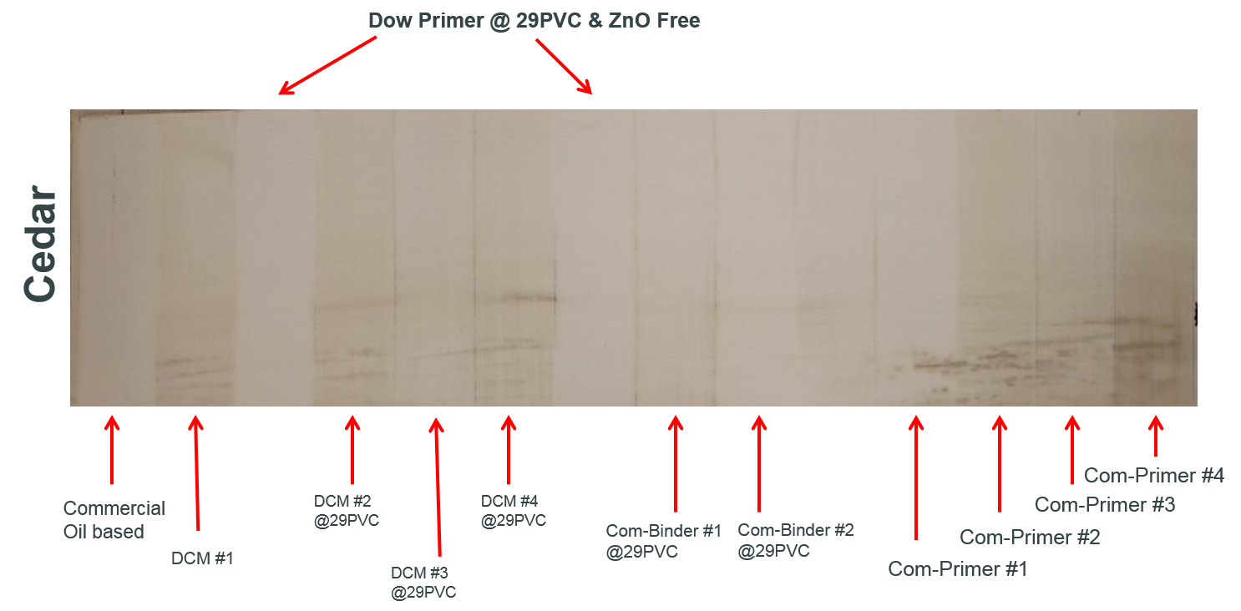
Tannin Stainblocking Performance
Notes:
Still room for improvement.

Slide 12
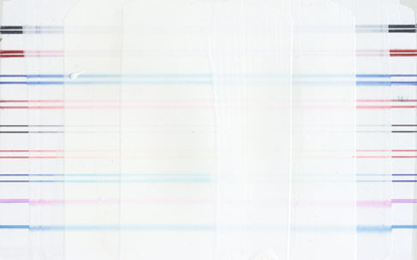
Marker Stainblocking Performance
DCM#1
Dow Primer
Black Sharpie
Red Sharpie
Blue PaperMate
Orange PaperMate
Black Pen
Red Pen
Blue Pen
Pink Washable
Blue Washable
Primer+ 1-Topcoat + 2-Topcoats 2-Topcoats + 1-Topcoat + Primer
Notes:
How & results

Slide 13
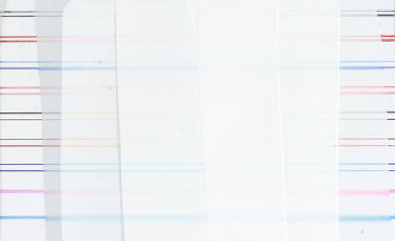
Marker Stainblocking Performance
Comm. Primer
Dow Primer
Black Sharpie
Red Sharpie
Blue PaperMate
Orange PaperMate
Black Pen
Red Pen
Blue Pen
Pink Washable
Blue Washable
Primer + 1-Topcoat + 2-Topcoats 2-Topcoats + 1-Topcoat + Primer

Slide 14
Dow Exposure Station: Spring House, PA

Slide 15
Real World Exposure Data
Many substrates available including wood, masonry, and metal
Various directions which accelerate different failures (i.e., North Vertical demonstrates accelerated mildew/mold growth)
Some key properties that are tested include crack and flake resistance, efflorescence, corrosion resistance, DPUR
Pine is most challenging for crack resistance due to inherent dimensional instability

Slide 16

Real World Exposure Data
Many substrates available including wood, masonry, and metal
Various directions which accelerate different failures (i.e., North Vertical demonstrates accelerated mildew/mold growth)
Some key properties that are tested include crack and flake resistance, efflorescence, corrosion resistance, DPUR
Pine is most challenging for crack resistance due to inherent dimensional instability
White pine exposed 24 months
2 Topcoats
Primer + topcoat
2 Topcoats
Primer + topcoat
2 Topcoats
Primer + topcoat

Slide 17
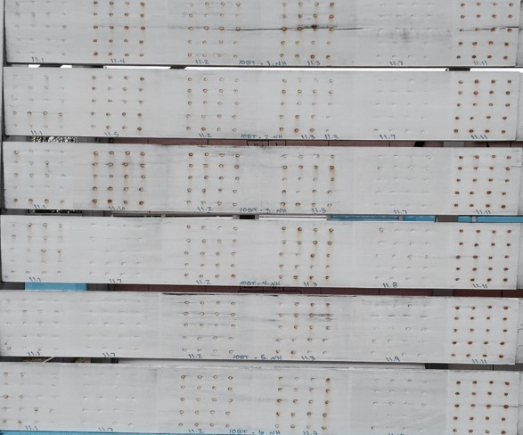
Metal Rust Resistance
20 nails per panel
Different primer per panel
Same commercial topcoat for all panels
Red box indicates two topcoats (no primer)
4 years exposure
Not all primers are created equal!

Slide 18
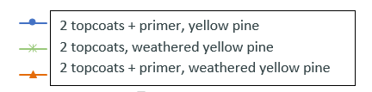
Real World Exposure Data

Slide 19
Real World Exposure Data

Slide 20
Paint and Primer in One
Early 2010s new primer technology entered the market
Popular with DIYers
Claim to eliminate the need to use a primer
Decreased time and money that a homeowner needed to spend on painting
Catch phrases were enticing
  One coat hide
  Self-priming
  One coat coverage

Slide 21
Real World Exposure Data
2 topcoats with primer
Commercial Paint and Primer in One

Slide 22
Summary
Primers are important in the paint industry as they help the topcoat’s ability to beautify (stainblocking and hiding) and protect (increased durability)
Oil-based primers have dominated the stainblocking primer market since they inherently block out stains at the substrate/primer interface
The primer market has transitioned to waterborne technology (lower odor and VOC)
With waterborne technology, stainblocking is more difficult as the stains are solubilized in the primer film and thus must be “locked” in place
Functional pigments (ZnO) can be used to improve stainblocking
Use of a primer is very beneficial over even the most challenging substrates and can extend the lifetime of the topcoat by years
Primer and topcoat demonstrate superior exterior durability when compared to Paint and Primer in One

Slide 23
®™ Trademark of The Dow Chemical Company ("Dow") or an affiliated company of Dow

Slide 24
HANDLING PRECAUTIONS
PRODUCT STEWARDSHIP
CUSTOMER NOTICE
Before using any product mentioned herein, consult the product’s Material Safety Data Sheet (MSDS)/Safety Data Sheet (SDS) for details on product hazards, recommended handling precautions and product storage.
Dow has a fundamental concern for all who make, distribute, and use its products, and for the environment in which we live. This concern is the basis for our product stewardship philosophy by which we assess the safety, health, and environmental information on our products and then take appropriate steps to protect employee and public health and our environment. The success of our product stewardship program rests with each and every individual involved with Dow products - from the initial concept and research, to manufacture, use, sale, disposal, and recycle of each product.
Dow strongly encourages its customers to review both their manufacturing processes and their applications of Dow products from the standpoint of human health and environmental quality to ensure that Dow products are not used in ways for which they are not intended or tested. Dow personnel are available to answer your questions and to provide reasonable technical support. Dow product literature, including safety data sheets, should be consulted prior to use of Dow products. Current safety data sheets are available from Dow.
Notice: No freedom from infringement of any patent owned by Dow or others is to be inferred. Because use conditions and applicable laws may differ from one location to another and may change with time, Customer is responsible for determining whether products and the information in this document are appropriate for Customer's use and for ensuring that Customer's workplace and disposal practices are in compliance with applicable laws and other government enactments. The product shown in this literature may not be available for sale and/or available in all geographies where Dow is represented. The claims made may not have been approved for use in all countries. Dow assumes no obligation or liability for the information in this document. References to “Dow” or the “Company” mean the Dow legal entity selling the products to Customer unless otherwise expressly noted. NO WARRANTIES ARE GIVEN; ALL IMPLIED WARRANTIES OF MERCHANTABILITY OR FITNESS FOR A PARTICULAR PURPOSE ARE EXPRESSLY EXCLUDED.
HANDLING PRECAUTIONS
PRODUCT STEWARDSHIP
CUSTOMER NOTICE

