Slide 1
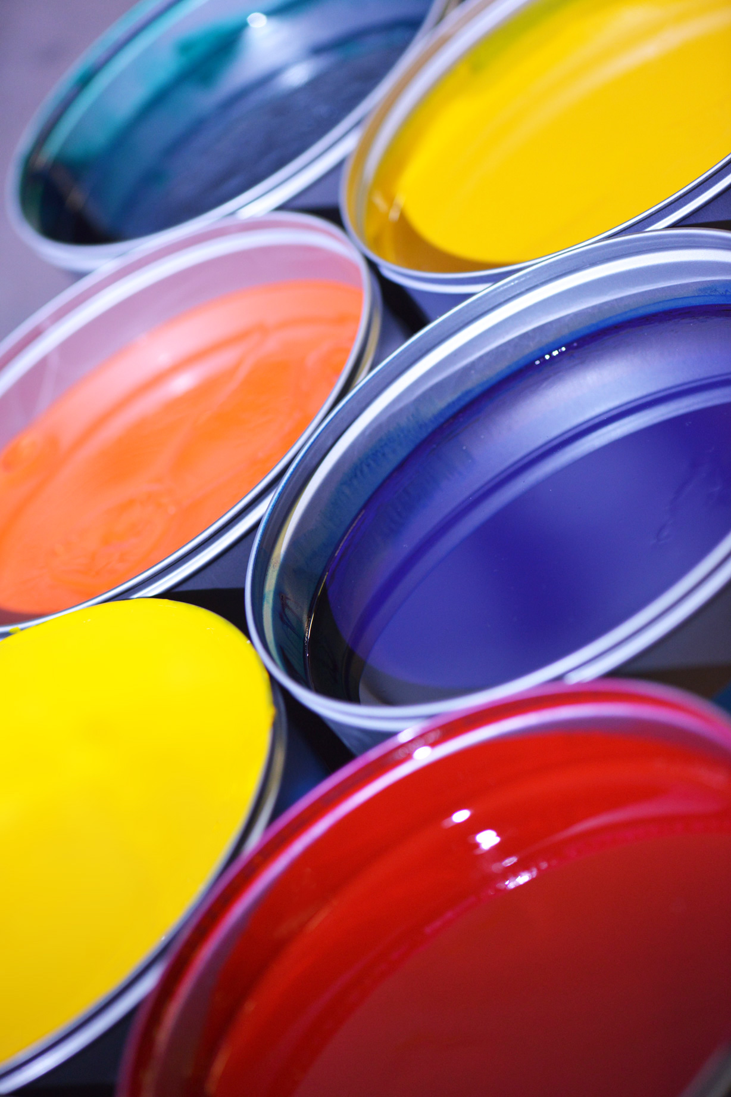
Addressing Color Trends with Pre-Made Pigment Dispersions
Latoska N Price, Business Development, NA – Southfield, MI

Slide 2
Today’s Outline
Market Areas
Environmental Regulations
Characteristics of Pigment Dispersions
Pigment Dispersions for Wood and Wood Composites
In closing

Slide 3
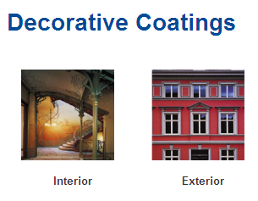
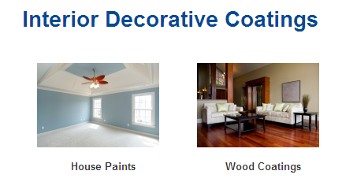
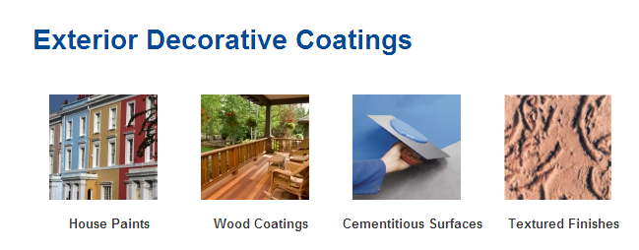
Key Markets & Typical Applications Architectural Coatings
Whatever your goal APEO-free or formaldehyde-free materials, low energy curing, or replacement of heavy metal pigments – Pigment Dispersions.

Slide 4
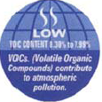
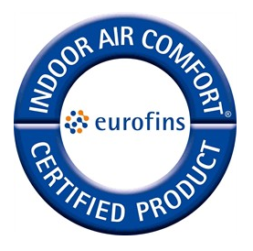
Low VOC Pigments Environmental Regulations & Label Requirements
Low VOC Environmental Regulations & Label Requirements
Focus to reduce VOCs in architectural paints through various environmental regulations and labeling programs

Slide 5
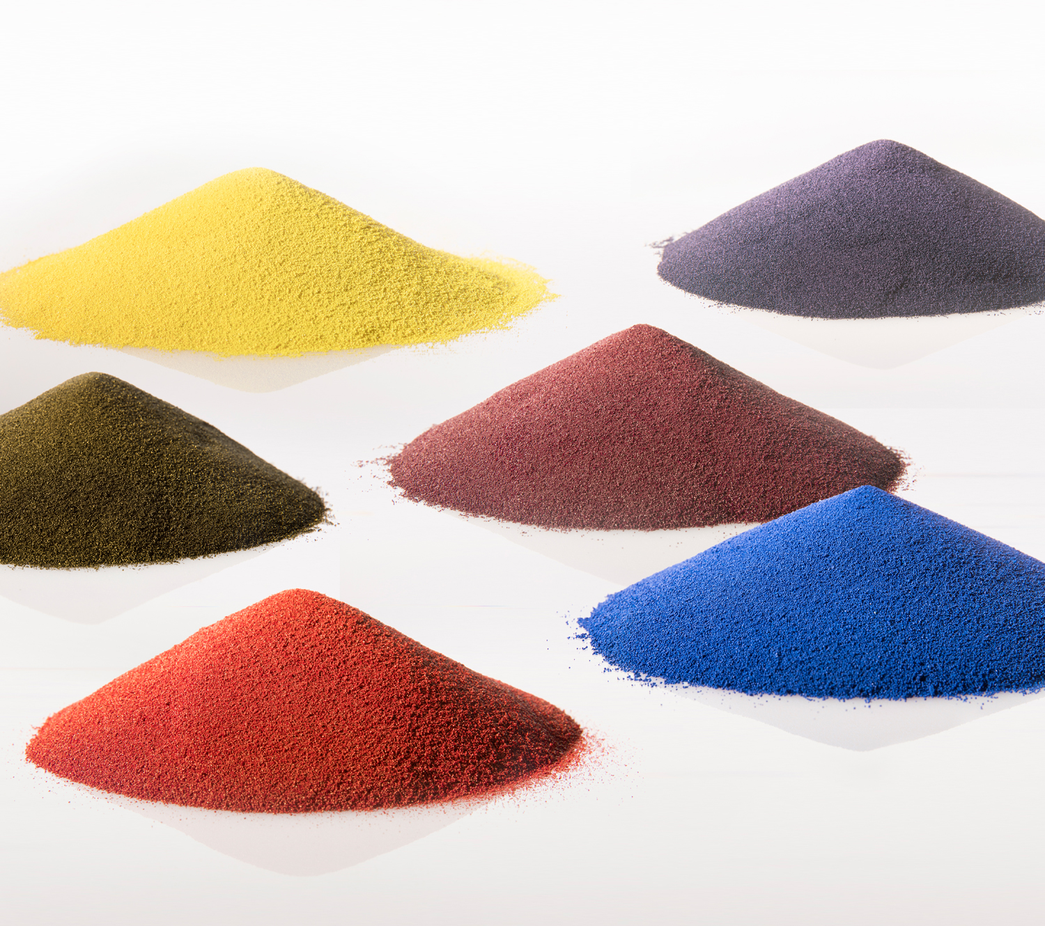
KEY QUESTIONS
Is the application solvent borne or water borne?
Is it for interior or exterior use?
Is metamerism an issue?
Is durability a concern?
Is there a need to adapt quickly to a color trend?

Slide 6
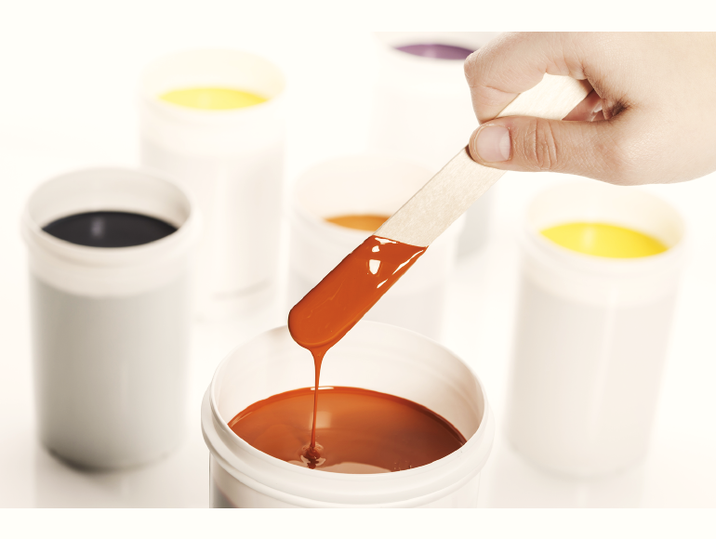
Why use pigment dispersions?
Enable cost saving in term of capital investment
A turnkey solution
Resources savings on quality control testing and production
Reduce development time
Greater resource allocation to your core business (paint production)
Products carefully selected to achieve a maximum of shades over large color gamut
Efficiently accommodate quick color changes

Slide 7
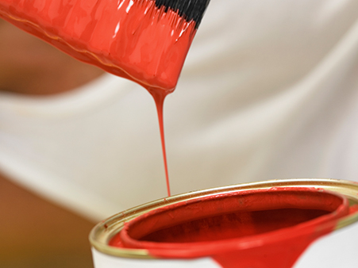
Types of pigment chemistries available
DPP
Quinacridones
Bismuth Vanadate
Dioxane
Phthalo Blue, Greens
Mixed Metal Oxides
Full range of pigment chemistries to cover a wide color range

Slide 8
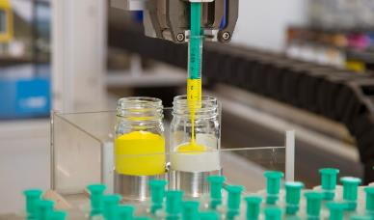
Main features Liquid Pigment Dispersions
Dispersed product form of organic and inorganic pigments
Consists of wide range of different pigment chemistries commonly used in IPT
Gives a wide spectrum of applicational properties (e.g. Interior, exterior, wood, WB industrial), covering complete color space
a optimized blend of surfactants and/or dispersants
Pigment | 8-70%
Surfactants | 8-15%
Antifoam | <1%
Antimicrobials/preservatives | <0.05%
Water (and humectants) | balance

Slide 9
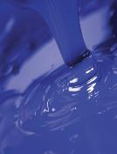
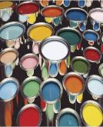
Pigment Dispersions characteristics desired for in-planting tinting (IPT)
Pigment preparations characteristics
In-plant tinting systems characteristics
Characteristics | Explanations
Color Strength | Pigment dispersed to its optimum to allow full value in pale and pastel shades
Color Stability | Storage stability and compatibility illustrates optimum formulation and ensures lower risk of Quality Control topics
Saturation | Maximum flexibility in formulating color shades, the higher the Chroma the more color space can be reached
Durability | Illustrates quality and allows for positioning of premium paints
Shade | Correct positioning for easier matching
Shelf Life | Ensures minimum stock issues and lower Quality Control problems
Opacity | For deep to full shades, opacity is valued due to lower film thickness requirements
Tinted in the factory (production plant)
Gravimetric dosing (manual or automatic) into drums/IBCs or cans
Limited number of shades produced (customer dependent)
Tinting process: predominantly batch tinting but also in-can tinting possible
Lifecycle: variable
Technical preparations: manageable (some hundreds of mixtures)
In-plant tinting (ready-mix, in factory)
In-can tinting (in-factory)

Slide 10
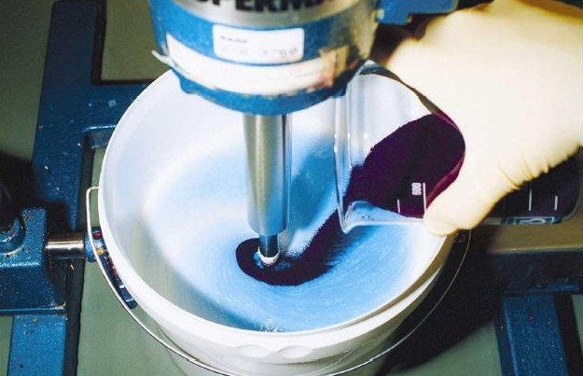
Stir-In Dry Pigments
Dry colorant technology for waterborne architectural paints
Simple stir-in with mild agitation
No high-energy dispersion needed
High pigment loading (~80% in most cases)
Free flowing, low dust product
Superior sustainability profile
True zero VOC content (solid granules)
APEO-free
Comprehensive range
Thorough color gamut coverage
High durability options (iron oxides, DPP, quinacridone)
NIR-reflective options for heat/energy management applications
Transparent iron oxides for wood stain applications (good aesthetics + UV protection)

Slide 11
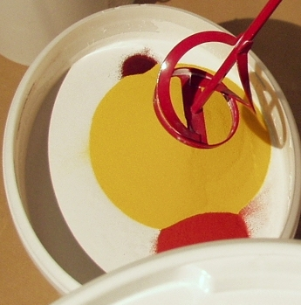
Stir-In Pigments Flexible, reproducible tinting on the spot
Stirring
Adding Dry
Pigment Dispersion
Application

Slide 12
Wood & Wood Composites

Slide 13
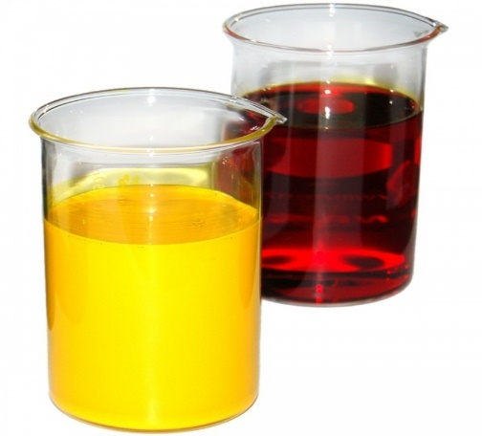
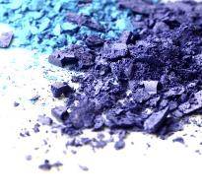
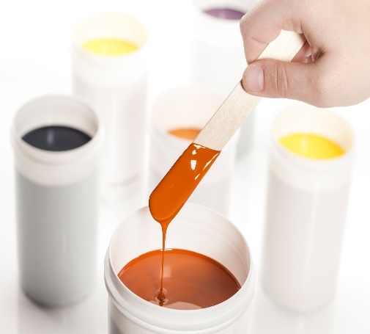
Available colorants in the market for Wood Coatings
Dye
Pigment
Pigment dispersions
always organic substance which is soluble in the application medium
organic or inorganic substance which is insoluble in the application medium (resin, solvent)
a ready-to-use form of organic or inorganic pigments, optimally formulated for use in wood coatings for indoor and outdoor applications

Slide 14
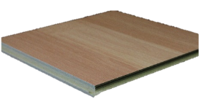
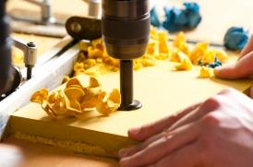
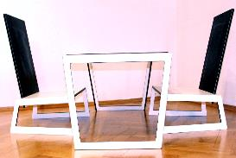
Pigment Dispersion to serve different market segments
Colorants for Identification of MDF, HDF and Particleboards
Colorants for
Design-MDF
Colorants for Laminates and Decorative Papers
Why colorants on wood?
Composites | Design | Identification | Functionality | Improved cost/ performance ratio
HDF |  | ✓ | ✓
Particleboard |  | ✓ | ✓
MDF | ✓ |  | ✓
HPL | ✓
Decorative Paper |  |  |  | ✓

Slide 15
Wood surface characteristics require protection and treatments
Porous surface
→ sensitive to humidity
Lignin degradation with UV light
→ not chemical resistant
→ change in colors
→ loss of mechanical strength
Fiber reorientation (dynamic surface telegraphing effect)
→ sensitive to humidity and temperature
Heavy traffic
→ reinforcement of wear
→ resistance is needed for wood flooring and decking
Cellulose biological degradation
→ not chemical resistant
→ loss of mechanical strength
Wood substrates, depending on the need, have to be protected and reinforced with surface treatments and coatings.

Slide 16
Why using Pigment Dispersions for Wood Coatings?
Esthetical
Protection
Level the natural wood color
Change the natural wood color
Replicate expensive wood
Protect the wood from degradation
Extend the lifetime of wood and coating

Slide 17
Pigment Dispersions have higher durability than Dyes
Comparison of Transparency
Comparison of Durability
8 days light exposure
Dye
8 days light exposure
Pigment
Dispersion

Slide 18
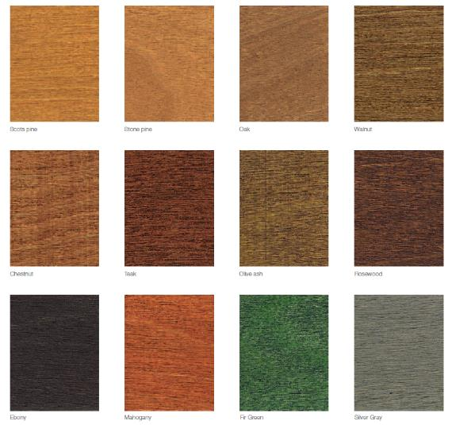
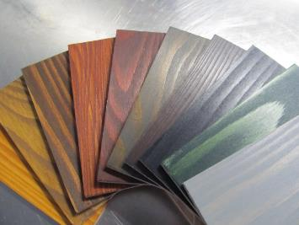
Coatings with tinted with Pigment Dispersions Typical wood color shade with glaze
Scots pine Stone pine Oak Walnut
Chestnut Teak Olive ash Rosewood
Ebony Mahogany Fir Green Silver Grey

Slide 19
In Closing
Pigment Dispersions provide cost savings by reducing waste caused by in-house grinding of pigments.
Whether in liquid or granular form, pigment dispersions are an efficient way to incorporate hard to grind pigments in paint formulations.
With a wide range of pigment chemistries available, pigment dispersions provide a framework for formulation efficiency.
Quickly and efficiently adapt to changing color trends.

