Slide 1
New Advances in 2nd Generation Light Stabilizers Functionality for the Coatings Industry
Pacific Northwest Society of Coatings Technology CoatingsFest
Victoria, British Columbia
October 11th, 2018
Dr. Chris Chiu
Chitec Technology
Presented by
Christopher J. Karwowski

Slide 2
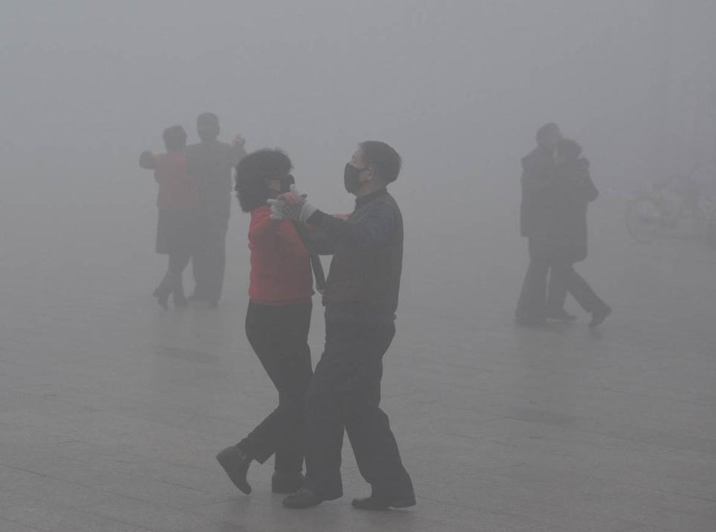
Pollution lies in the shadow of civilization.

Slide 3
2017 European Coatings Poll
50% of the attendees indicated that
water-borne technology is
the most important future technology
for the coating industry.

Slide 4
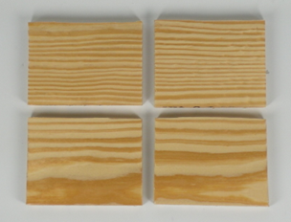
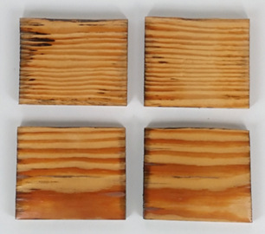
Water-borne (WB)
Water-borne (WB) technology is mature for interior coatings. Exterior Coatings are still evolving with research moving toward high performance durability similar to solvent systems.
Outdoor initial
41 day
blank
A
blank
A
B
C
B
C

Slide 5
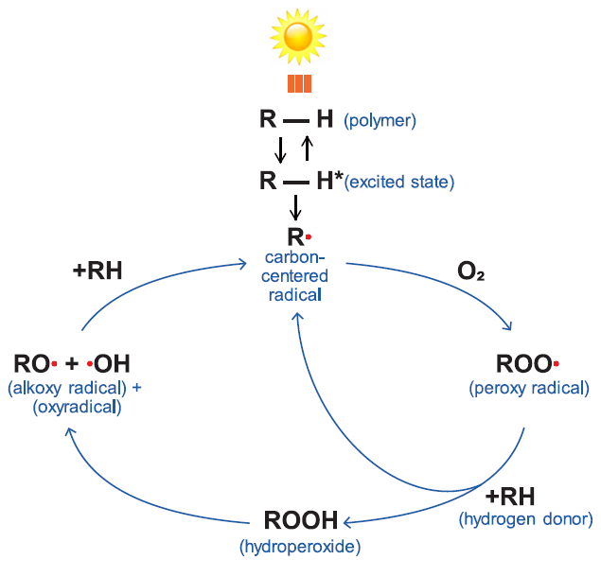
Photo-oxidation pathway
1st Line of Defense : UVA
280nm - 400nm
“Heat barrier”
2nd Line of Defense: Quencher
“Ice cube”
3rd Line of Defense: HALS
“Extinguisher”

Slide 6
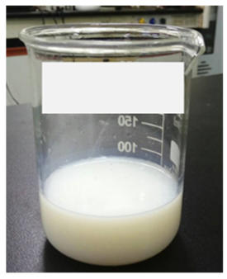
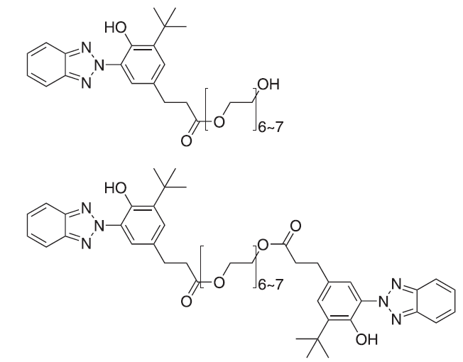
Commodity WB UVA
Hydrophilic BTZ is a liquid BTZ UVA (see below) which has been formulated as the premier UV protector for WB coatings. Its hydrophilic nature allows it to be easily emulsified with or without hindered amine light stabilizer (HALS). However, in exterior coatings, it is only slightly better than nothing at all.
Hydrophilic BTZ
Solution

Slide 7
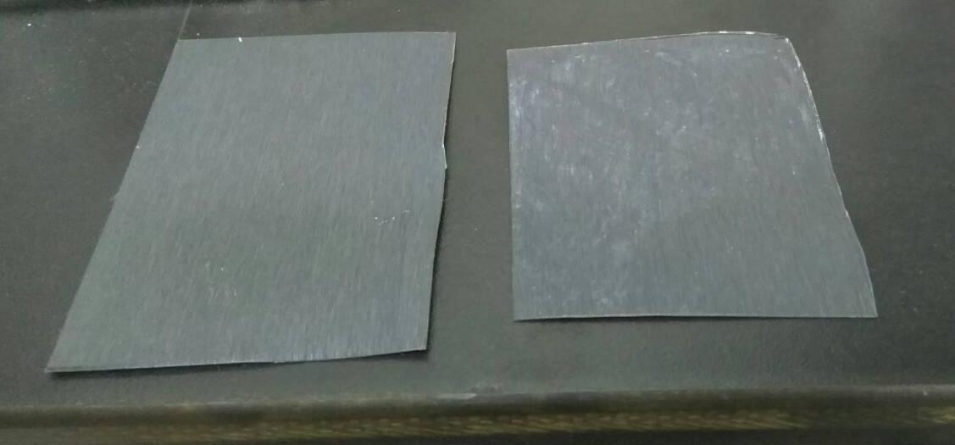
Hydrophilic BTZ are not dependable
Many customers saw gaps between data performed by outdoor exposure and WOM.
WOM
Outdoor exposure
Why? We hypothesize acid rain contamination.

Slide 8
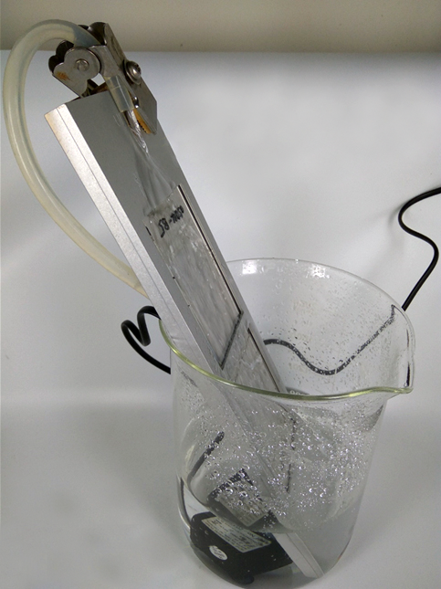
Water flushing experiments
Purpose | to mimic the rain fall flushing effect on UVA in the coatings.
Substrates | PET film or glass plate
Resin systems | Polyurethane dispersion (PUD) and water-borne acrylic (WBA).
UVA concentration | 0.1% by weight
Coatings thickness | 60 microns
Water flow rate | 1.8L/min
Temp. | 20-25 °C
QUV lamp | 340 nm
Cycle | QUV 48 hours followed by water-flushing 24 hours.
Flow rate: 1.8 L/min
PET film

Slide 9
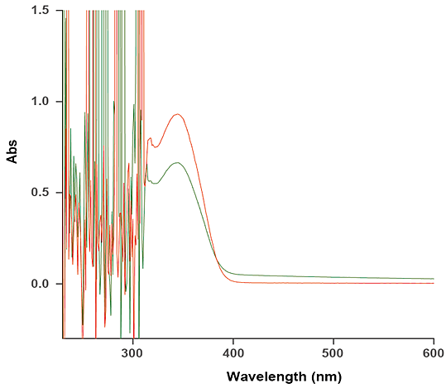
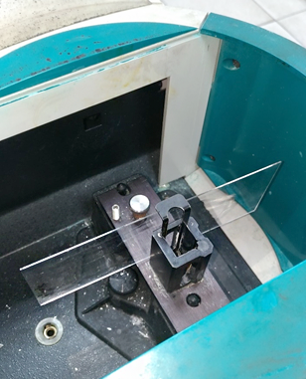
UV absorbance show the life of UV absorber
Hydrophilic BTZ initial
Hydrophilic BTZ after flushed with water five cycles
25% loss of UVA

Slide 10
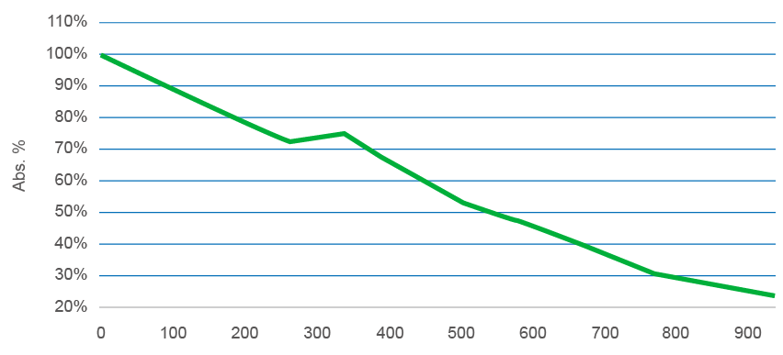
Hydrophilic BTZ vulnerable to water flushing
After 15 cycles, nearly 1,000 hours, Hydrophilic BTZ lost more than 80% of its functionality. The result is expected due to the hydrophilic nature of Hydrophilic BTZ. However, the speed of loss is astonishing. Therefore, it is recommended that Hydrophilic BTZ should not be used in exterior applications that have exposure to rain.

Slide 11
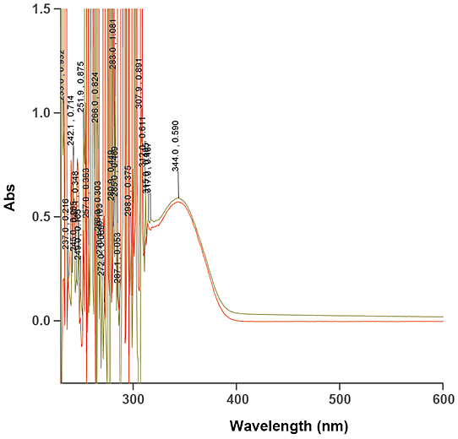
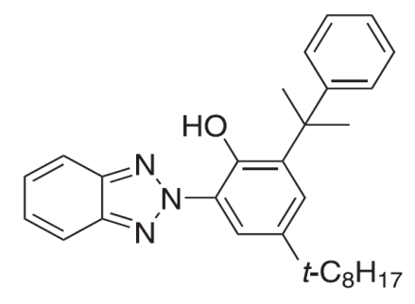
First generation of Chiguard® WB
Solid Hydrophobic BTZ was designed to prevent degradation issues with water flushing. It is a dispersion of solid BTZ UVA as shown below. It shows no apparent lose of UV absorbance after water-flushed for the first 2 cycles.
Solid Hydrophobic BTZ WB initial
Solid Hydrophobic BTZ WB
after 2 cycles

Slide 12
Solid Hydrophobic BTZ
 | 1st G WB
Active ingredient | 20% (solid)
Inactive ingredients | 10-15%
Compatibility with resin | Low
Phase separation | 3 months min.
Production cost | High
Structure of the active ingredient

Slide 13
Limit of First generation WB
The maximum dosage of Solid Hydrophobic is only 0.5%. More than 0.5% gives opaque appearance after baking.
PUD +
0.5% 1st G WB
PUD +
1% 1st G WB
PUD +
2% 1st G WB
PUD +
2% 2nd Generation BTZ

Slide 14
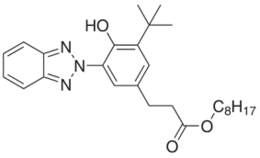
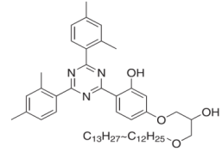
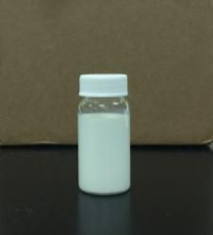
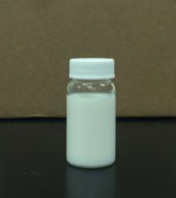
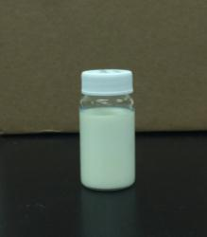
2nd Generation of WB UVA and WB HALS
 | 2nd Generation BTZ WB | 2nd Generation Hals WB | 2nd Generation Triazine WB
Active content | Liquid BTZ UVA | Liquid acid resistant HALS | Liquid TRZ UVA
Structure
Particle size | <500nm | <500nm | <500nm
Appearance | White milky emulsion | White milky emulsion | Pale yellow emulsion

Slide 15
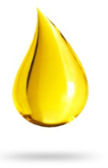
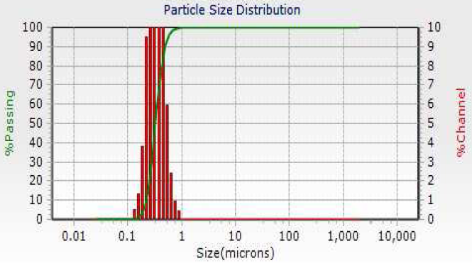
Chiguard® WB technology is a product of nanotechnology
Emulsifier A
Emulsifiers
Cell wall destruction
Emulsifier B
Oily UV absorber
Nano Micelles
Stabilizing nano size micelle is a result of 5 years overwhelming research work.

Slide 16
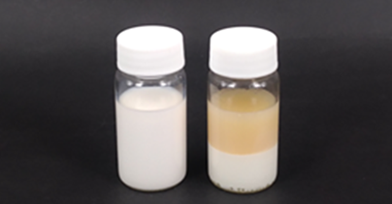
Five years of R&D explained!
2 months heat stability test at 60 °C and cooling stability at 10 °C without phase separation. In other words, one test took 2 months to know it is good or not!
2nd Generation BTZ WB is stabilized in 60°C
A
B
A: The appropriate emulsification process achieve the excellent stability B: Inappropriate emulsification process, likely to cause oil and water separation

Slide 17
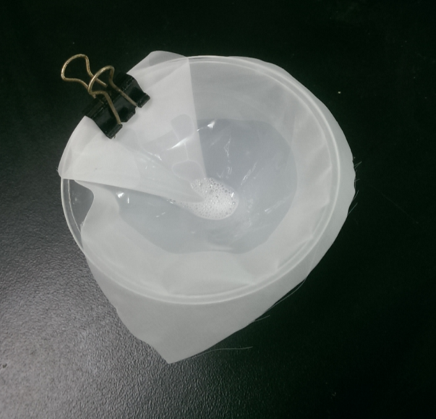
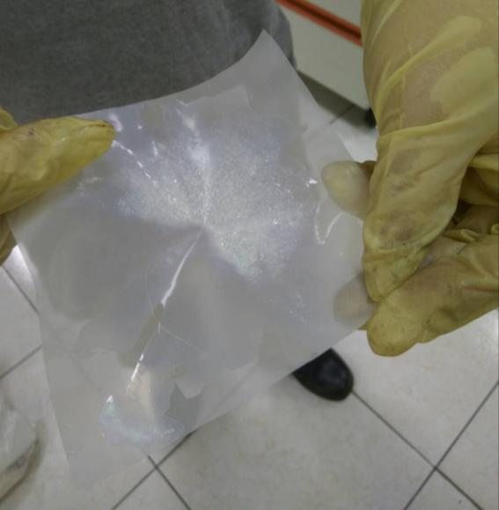
Compatibility tests
Over 50 resins were tested for compatibility. If compatibility issue occurred, defects on coatings can be easily observed. Acrylic based UVA are more suspected to have compatibility issue.

Slide 18
2nd Generation WB vs. Competition
Only two companies in the world supply emulsified water-borne UVA, one is Chitec and the other BASF. Their technologies differ in how to stabilize the micelles. Chitec uses emulsifier cocktails and BASF relies on acrylic-based encapsulation*.
 | 2nd Generation WB LS | Competition
Active concentrations | 30% | 20-40%
Inactive concentrations | 1-3% | 10-20%
Stabilizing means | emulsifiers | Polyacrylates shell
*This process is covered by parent no. US 2006/0287416 A1, filed on Sept. 1, 2006.

Slide 19
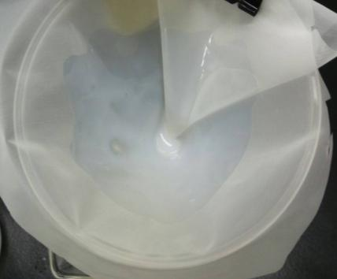
The advantage of inter-miscibility
2nd Generation BTZ, Hals, and Triazine WB Technology can be mixed in any ratio to generate a stable emulsion.
BTZ UVA
Triazine UVA
HALS
Mixing experiment
Stable emulsion

Slide 20
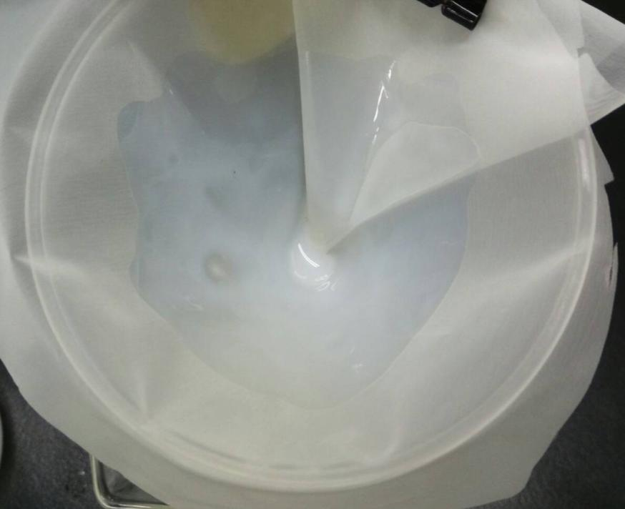
The advantage of inter-miscibility
2nd Generation BTZ, HALS, and Triazine Water Borne Technology
Conditions after one month
Stable emulsion

Slide 21
Life of 2nd G WB in WBA
UVA retention Acrylate QUV/pH:7
QUV340nm / pH:7 wash Test (hours)
Triazine WB
BTZ WB
Hydrophilic
BTZ / Hals WB
BTZ WB and Triazine WB showed significant stability against water-flushing over Hydrophilic BTZ with or without HALS in WBA coatings system. Triazine UVA chemistry did not provide extended durability in this system.

Slide 22
Life of 2nd G WB in PUD
UVA retention PU QUV/pH:7
QUV340nm / pH:7 wash Test (hours)
Triazine WB
BTZ WB
BTZ/Hals blend
Hydrophilic/Hals
BTZ WB and WB indicate better durability in the PUD system against the Acrylate system under water-flushing treatment, HALS was able to increase the durability when used with BTZ WB as indicated.

Slide 23
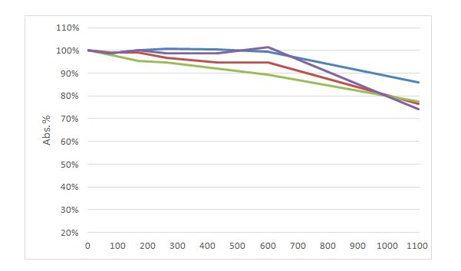
Life of 2nd G WB without water-flushing
UVA retention Acrylate QUV340nm/Cond.
QUV340nm/Cond. Test (hours)
Triazine WB
BTZ WB
Hydrophilic
BTZ WB/Hals

Slide 24
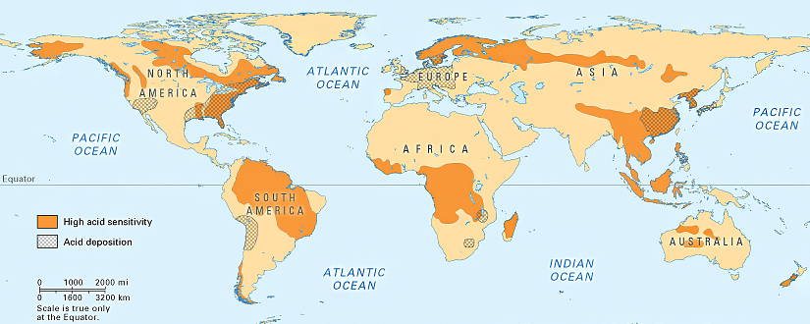
Acid rain fall in the World

Slide 25
Life of 2nd Generation WB in WBA under
Simulated Acid Rain flushing
UVA retention Acrylate QUV/pH:4
Abs. %
QUV340nm / pH:4 wash Test (hours)
Triazine WB
BTZ WB
Hydrophilic
BTZ/Hals blend
QUV340nm / pH:7 wash Test (hours)
Triazine WB
BTZ WB
Hydrophilic
BTZ/Hals blend
Simulated Acid Rain flushing decreased the durability of UVA’s in the WB Acrylate system than Neutral pH water flushing as shown in the solid lines. However, the durability can be increased by adding HALS as shown on the purple line.

Slide 26
Life of 2nd Generation WB in PUD under
Simulated Acid Rain flushing
UVA retention PU QUV/pH:4
QUV340nm / pH:4 wash Test (hours)
Triazine WB
BTZ WB
Hydro
BTZ/Hals Bld
Hydro/Hals Bld
QUV340nm / pH:7 wash Test (hours)
Triazine WB
BTZ WB
Hydro
BTZ/Hals Bld
Hydro/Hals Bld
Surprisingly, Simulated Acid Rain flushing increased the durability of the Hydrophobic UVA’s in PUD to more than 90% in 1100 hours.
Earlier hypothesis would have expected a drop in durability instead of increasing.

Slide 27
Summary
Chitec has introduced two 2nd generation WB UVA’s and one premier WB HALS which showed significant resistant to water-flushing. They are ideal for all water-borne applications.
Hydrophilic BTZ was washed away from coatings easily, so it is not recommended to applications exposure to heavy rain fall and including Acid Rain environment.
Simulated Acid Rain flushing decreased the durability UVA’s in WB Acrylate systems than water flushing. However, this can be overcome adding HALS.
Surprisingly, unlike water flushing, Simulated Acid Rain flushing increased the durability of the Hydrophobic UVA’s in PUD instead of decreasing the durability as expected.
In this testing PUD’s indicate to be more durable than WB Acrylate’s against Simulated Acid Rain testing based on the Simulated Acid Rain flushing experiments.

Slide 28
Acknowledgement
Dr. Chris Chiu Ph.D Author
Heidi Lu
Milly Hung
The Outstanding R&D Chemists at Chitec Taiwan
The PNWSCT Technical Advisory Board

