Slide 1
Future of Paints:
Innovations in High Performance Pigments and Manufacturing
Nilanjan Chakrabarti, PhD, Technical Manager,
Sun Chemical Corporation

Slide 2
Innovations in HPP and manufacturing for coatings
Agenda
Market paint applications
Pigments Innovations for Coatings
High Performance Red for Architectural
Classical Yellows for Architectural
Pigment Blues for Architectural/ Industrial
Pigment Manufacturing
Classical and High Performance
Sustainable smart North American manufacturing

Slide 3
Coatings by application: Architectural dominant

Slide 4
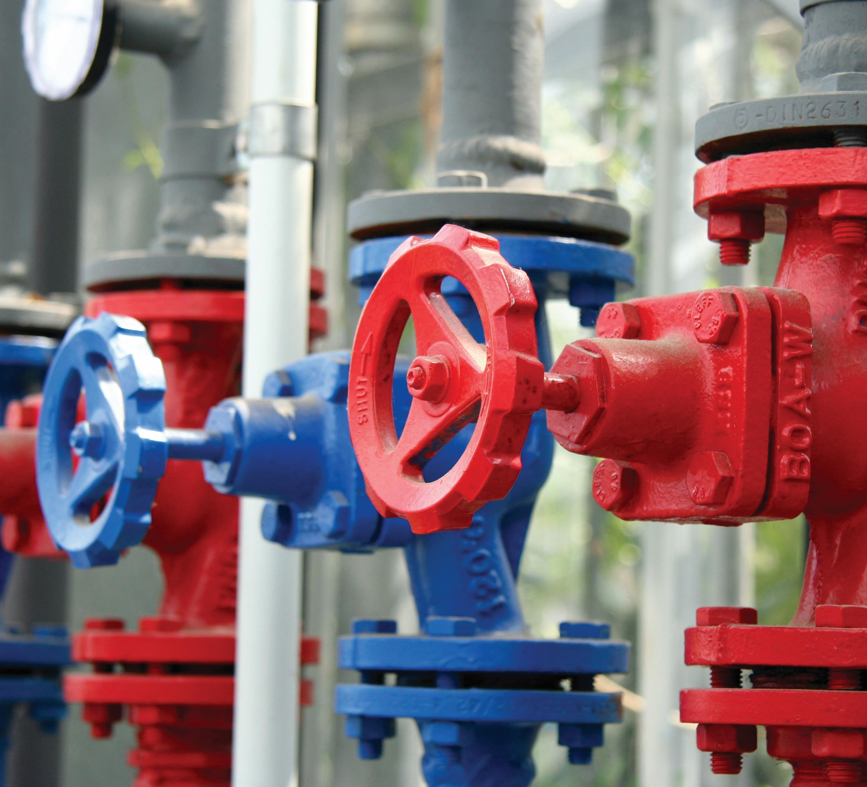
Pigment Innovations for coatings
Pigments Innovations for Coatings
High Performance Red for Architectural
Classical Yellows for Architectural
Pigment Blues for Architectural/Industrial

Slide 5
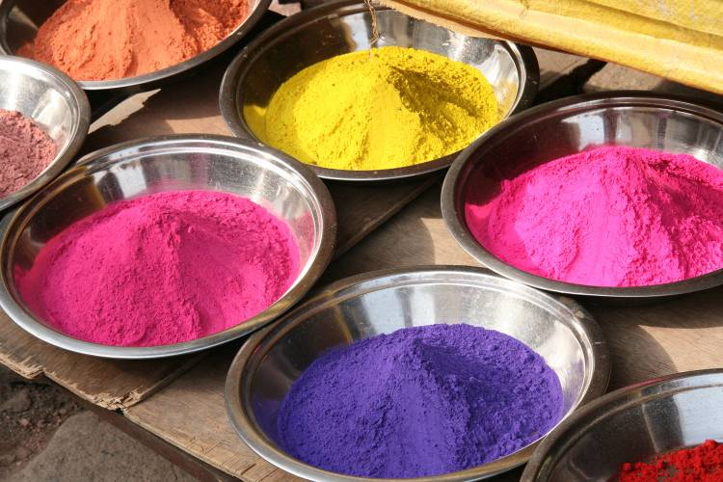
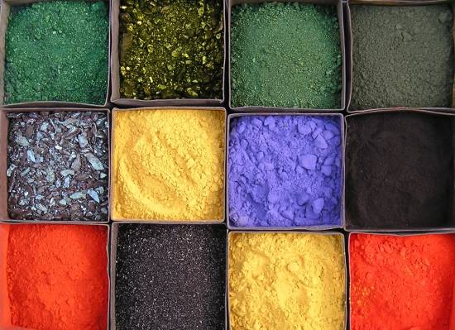
High Performance Organic Pigments
Quinacridone Magentas
Quinacridone Violets
Quinacridone Reds
High Performance
High Performance
High Performance
Special Phthalocyanine Blue & Greens
DPP Reds
High Performance
High Performance
Perylene Reds & Violets
High Performance
Indanthrone Blue
Carbazole Violet
High Performance
High Performance
Isoindoline Yellow
Benzimidazalone Oranges & Yellows
High Performance
High Performance
Notes:
5
Sun chemical is Solid in our offerings of HPP and are getting stronger every day.

Slide 6
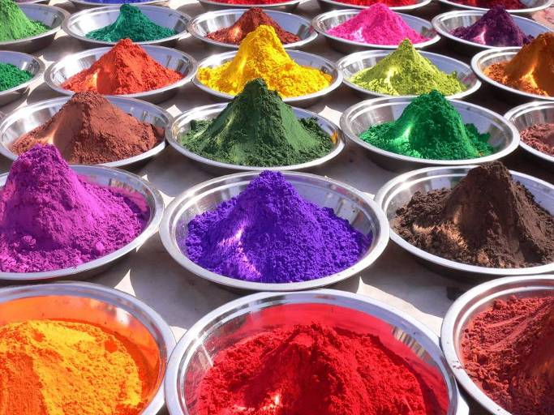
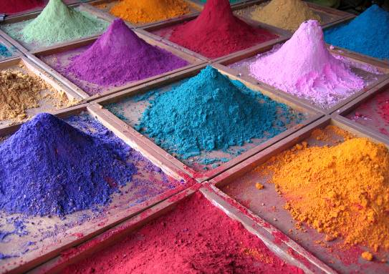
Classical Organic Pigments
Phthalo Green
Classical Organic
Azo Oranges
Classical Organic
Azo Yellows
Carbazole Violet
Classical Organic
Classical Organic
Phthalo Blue
Classical Organic
Azo Reds
Classical Organic
Notes:
6
We have an unrivaled pallet of organic pigments. Over 300 codes coving classical pigments alone. Things like PCN, PV23, red 2 b, diarylides, …

Slide 7
High Performance Pigments Innovations
High Performance
Color
Durability
Organic Pigment Technology
Sustainable Manufacturing
Green with water conservation

Slide 8
Organic Pigment Technology
Physics and Physical Chemistry are key to understanding organic pigments and color
Particle Size (Primary Particles)
Particle Shape
Agglomerates, Aggregates
Surface Area
Crystal Morphology
Surface Energy
Surface Charge
Particles
Surfaces

Slide 9
Pigment Particles
Particle Associations
Primary Particle
Agglomerate
Aggregate

Slide 10
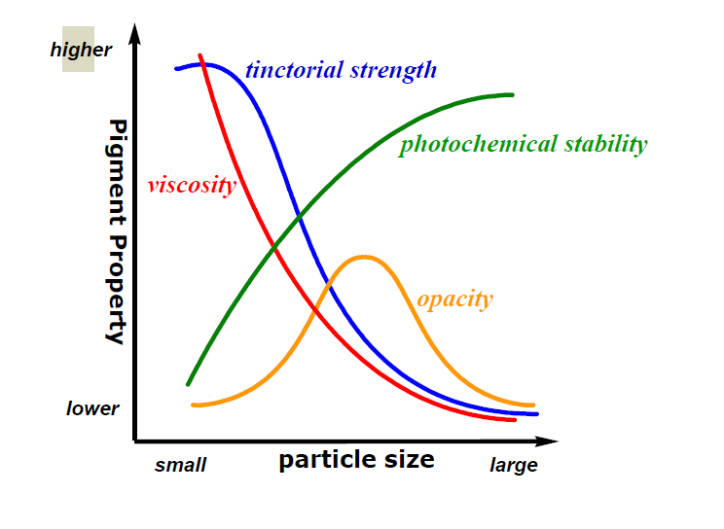
Pigment Particles
Effects of Particle Size

Slide 11
Pigment HPP and Classical Innovations
PR122
PY74
PB15

Slide 12
Classes of Organic Pigments
NEW!
Quindo Magenta 122: 228-6628
Quinacridones
Violet 19 (Unsubstituted)
Red 122 (Dimethyl)
Red 202, 207, 209 (Dichloro)
Violet 55 (Dimethoxy)
C. I. Pigment Red 122

Slide 13

High Performance Pigments
Quindo Magenta 122: 228-6628, 228-3122
Description: PR122 offers very clean bluish shades of red, commonly referred to as magenta or pink. It has excellent fastness to heat, light, and weathering.
  228-6628 is a unique crystal quinacridone that is highly chromatic and bluish compared to typical PR122 while demonstrating better durability.
  228-3122 is a transparent unique crystal quinacridone that is highly chromatic and yellowish compared to typical PR122 while demonstrating similar fastness.
Intended markets: Architectural better hiding and durable
228-6628. Automotive OEM & Refinish, Automotive Plastic Trim,
for 228-3122.

Slide 14
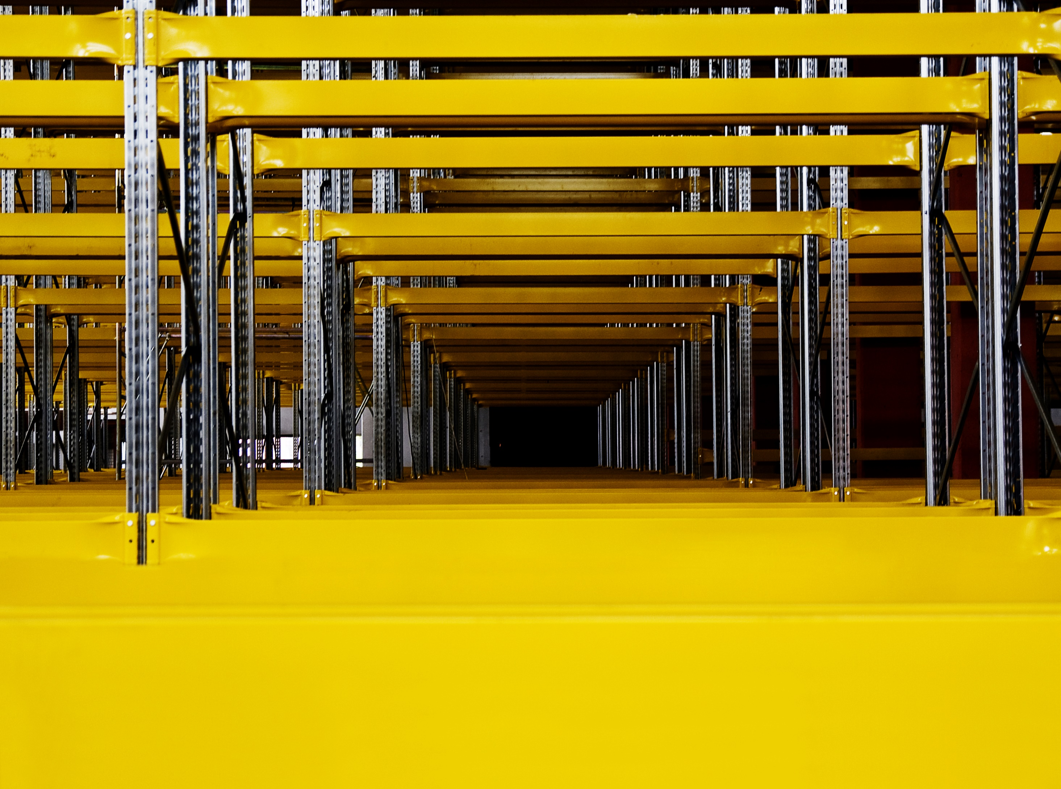
Yellow 74: 272-4615
Do More with Less
10-15% extra strength means energy, water and waste savings
Solutions Tailor made for your needs of opacity & durability
Global resources, local service

Slide 15
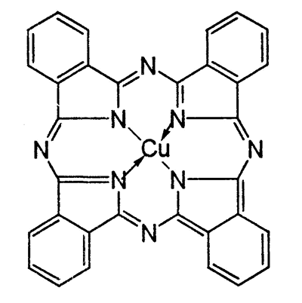
Classes of Organic Blue Pigments
Phthalocyanines
Blue 15:1
Blue 15:2
Blue 15:3
Blue 15:4
Blue 15:6
C.I. Pigment Blue 15

Slide 16
Palomar Blue 15: 248-4848
New High Strength, Non-Flop Blue for Coatings
Phthalo Blue 15 based on SunChemical patented technology
Significantly improved dispersability in waterborne systems compared to competitive technologies
Greatly improved strength and value-in-use
  40-50% extra strength in WB vs 248-4816
  35-40% in Solvent systems
Very good weathering

Slide 17
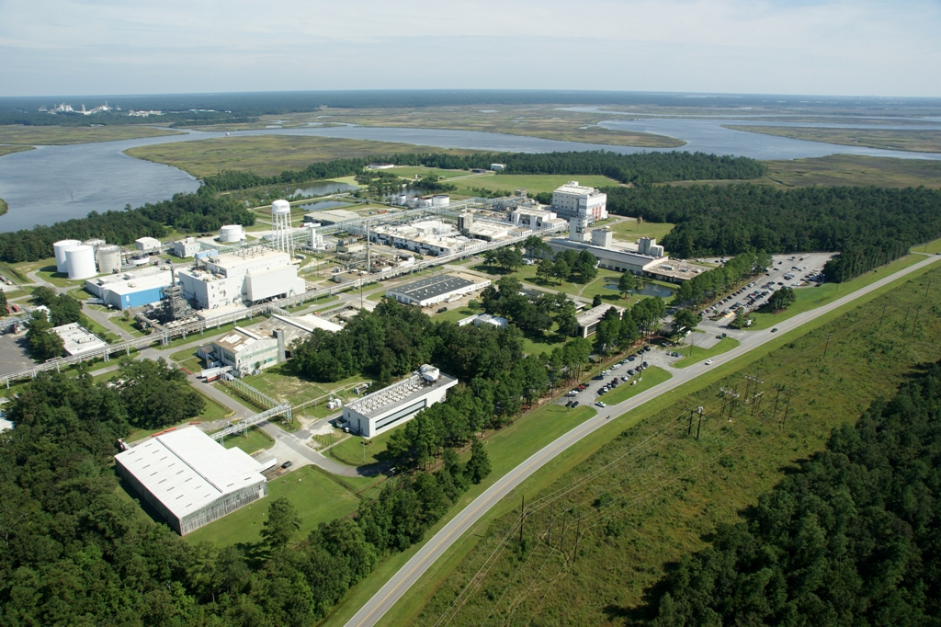
Bushy Park, SC, USA
2018 ChemStewards® Award
Independently recognized for exceeding federal requirements for environmental, health and safety - Society of Chemical Manufacturers

Slide 18
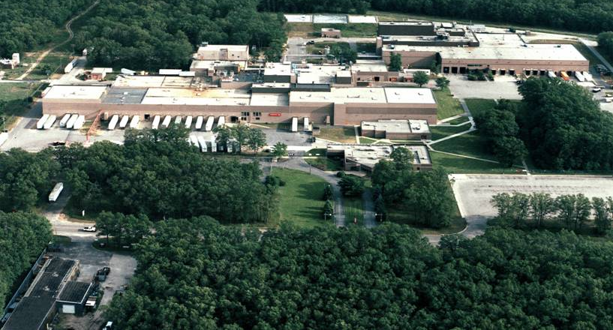
Muskegon, MI, USA
Major Global site
620 Wooded acres on Lake Michigan
8 Buildings with over 340,000 sq. ft. of manufacturing space
140 Employees making 120 products

Slide 19
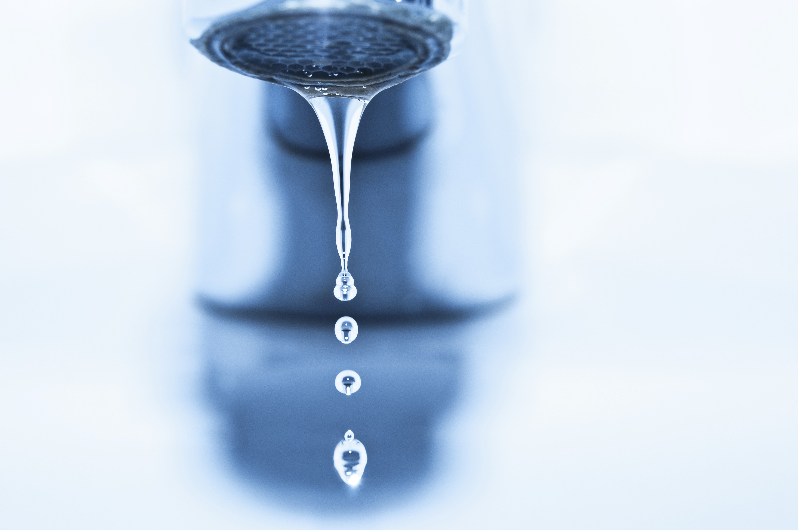
Sustainability: Cooperation and Resource Management
Water Conservation
for Yellow 74
We utilize water from a neighboring production site…
To meet 95% of our Azo production water requirements…
Saving millions of liters of fresh
water each day for drinking and
the local community.

Slide 20

Yellow 74 Sustainability: Engineering Solutions
CO₂ Reduction
28 CO₂ reduction programs at Muskegon, USA plant
420 tons CO₂ reduced in first year of project
1,800 tons CO₂ removed
since 2014

Slide 21
Innovations in HPP and manufacturing for coatings
Pigments Innovations for Coatings
High Performance Red for Architectural
Classical Yellows for Architectural
Pigment Blues for Architectural/ Industrial
Pigment Manufacturing
Classical and High Performance
Sustainable smart North American manufacturing

Slide 22
Contact
Nilanjan Chakrabarti, PhD, Technical Manager
nilanjan.chakrabarti@sunchemical.com
Michael Venturini, Marketing Director - Coatings
michael.venturini@sunchemical.com

Slide 23


Thank You!
Questions?
Although the information presented here is believed to be reliable, Sun Chemical Corporation makes no representation or guarantee to its accuracy, completeness or reliability of the information. All recommendations and suggestions are made without guarantee, since the conditions of use are beyond our control. There is no implied warranty of merchantability or fitness for purpose of the product or products described herein. In no event shall Sun Chemical Corporation be liable for damages of any nature arising out of the use or reliance upon the information. Sun Chemical Corporation expressly disclaims that the use of any material referenced herein, either alone or in combination with other materials, shall be free of rightful claim of any third party including a claim of infringement. The observance of all legal regulations and patents is the responsibility of the user.
SUNCHEMICAL is either a registered trademark or trademark of Sun Chemical Corporation in the United States and/or other countries. DIC is a trademark of DIC Corporation, registered in the United States and/or other countries. Copyright © 2018 Sun Chemical Corporation. All rights reserved.

