Slide 1
Critical Role
APEO-free Surfactants
Provide in the Paint Can
PNWSCT
October 10-12, 2018
.

Slide 2
OUTLINE
Ingredients in a Paint Can
Surfactants
- Definition
- Key Features and Benefits
APE- Containing Surfactants
Move to APEO-free Surfactants
New APEO-free Surfactant
- Performance in High Quality Flat (all Acrylic)
- Performance in Premium Semigloss (all Acrylic)
- Performance in Economy Flat (PVA)
- Performance in Economy Flat (Styrene Acrylic)
Summary

Slide 3
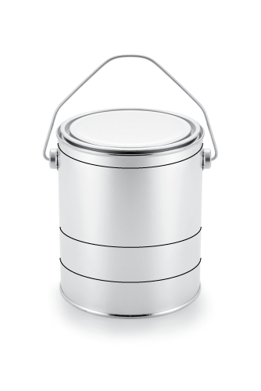
Waterborne Latex Paint
ADDITIVES – Performance, Processing, Storage, Application
Defoamer - Complex mixtures
Surfactants- Hydrophobe/Hydrophile
Dispersant- monoacid, polyfunctional acid polymers,
Rheology modifier - Non-Associative, Associative, cellulosic
Specialty additives - F/T, open time, adhesion promoters, block resistance, gloss, etc.
Four key ingredient categories in latex paint
< 5%
Additives
LIQUID – Application and Fluidity
Water
Solvents – glycols, coalescing agents
~40%
Liquid
PIGMENTATION – Appearance, Gloss, Performance
TiO2
Extenders
Colorants
Additives
~25%
Pigments
Binder/Resin
BINDER – Continuous film, Adhesion, Durability
Acrylic – Exterior/Interior; Flat to gloss
Styrene Acrylic - Exterior/Interior; Flat to gloss
Vinyl Acrylic – Interior; Flat to gloss (blends for exterior)
VAE – Interior; flat to semi gloss (blends for exterior)
VA/VEOVA – Exterior Flat to gloss
~25%
Additives – components of the paint that are added in small amount to provide special properties to the wet paint as well as the dry film – “Small does make a big difference”.

Slide 4
Surfactants – Definition
Surfactants: contracted from SURFACE ACTIVE AGENTS, these are ADDITIVES which reduce surface tension of a liquid and may form micelles thereby :
improve WETTING (wetting agents)
- overcome the cohesive tendency of water
help DIPSERSE pigments (DISPERSANTS)
- absorbs onto pigment and assists in its wetting in water
- facilitates wetting of gases on pigment surface which cannot be removed via grinding
inhibit foam (DEFOAMERS)
emulsify (EMULSIFERS)
- lower interfacial tension and stabilize polymer particles
Surfactants are classified by their charge
- ANIONIC: negatively charged hydrophile
- CATIONIC: positively charged hydrophile
- NONIONIC: hydrophile with NO charge
- AMPHOTERIC: charge on hydrophile dependent upon pH
Hydrophilic Head Hydrophobic Tail
Hydrophillic Groups - Water “loving” ,polar, soluble groups Hydrophobic Groups - Water insoluble (hydrocarbon chain) groups
2
Novecare (Confidential)
4 May 2018

Slide 5
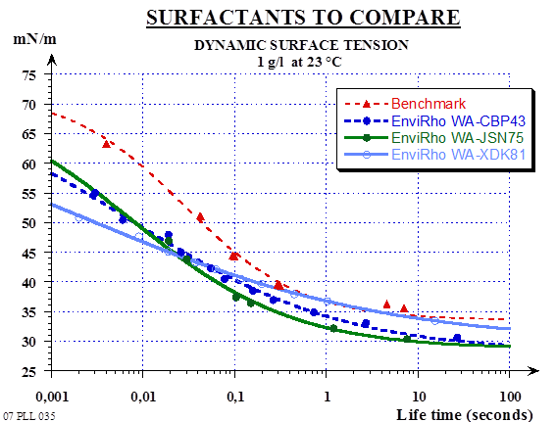
Surfactant Features
Dynamic Surface Tension Reduction
Nature and concentration of the Surfactant determines how much the surface
tension can be reduced
Speed of diffusion determines how fast wetting/surfactant migration will occur
Coating systems need good leveling and flow to have an appealing appearance!
Surface Tension related paint film defects:
Orange Peel
Fish-eyes
Craters
De-wetting/Crawling
Pinholes
Silking
Product #1
Product #2
Product #3
Quick surface tension drop indicates quick migration of surfactant to interfaces.

Slide 6
Surfactants in the Paint Can
Improve substrate wetting
Development of Color Strength
Nonionic surfactants work best
Surfactants can help with dark rub up (colorant flocculation) or light rub up (pigment flocculation)
Stability
Need to Monitor Use Level….
Foaming
use as little as possible
use appropriate defoamer
Water sensitivity
use as little as possible
nonionics less troublesome than anionics, but are also usually less efficient and must be used at higher concentrations

Slide 7
Substrate Wetting
Paint White “Satin” paint
Substrate Silicone release paper
Additive 1% (active) based on total paint
DD Blade with depth
of cut = 150 μm (~5 mils)
Application by brush
Surfactant No Surfactant Surfactant No Surfactant

Slide 8
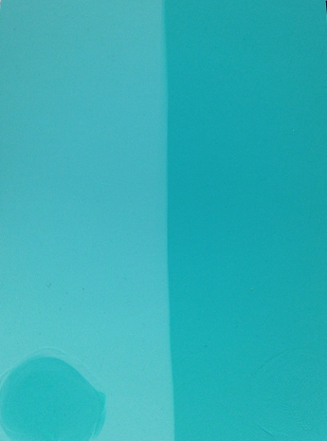
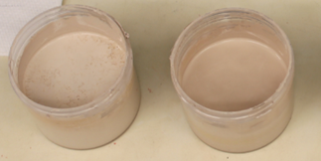
Color Issues
Some common challenges when colorant is added to paint…
Color Float
Color Acceptance
Color Development
Poor vs. Excellent color development and acceptance
Poor vs. Excellent resistance to colorant float
The right surfactant package in the paint formulation can help minimize or
eliminate these problems

Slide 9
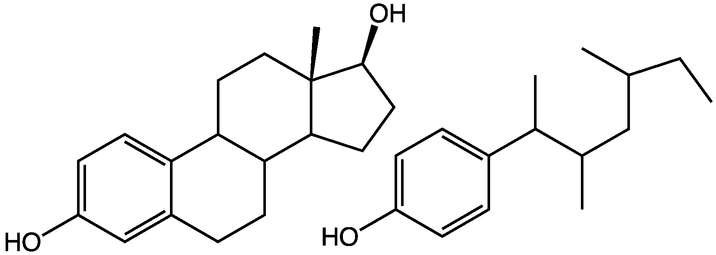
Alkylphenol Ethoxylates (APE)
Have been around a long time
Versatile, cost effective surfactants
Use in a wide variety of applications
Concerns
Biodegradability
- “60% minimum biodegraded within 28 days”
Toxicity of degradation products
Bioaccumulation
- low mole APEO’s are not water soluble
- readily absorbed onto surfaces
- can lead to accumulation and sediment in waterways
- can lead to accumulation in aquatic species
Viewed as an Endocrine Disruptor
- chemicals that interfere with hormone systems in animals
- can cause cancerous tumors, birth defects, etc.
Structure of the hormone estradiol and one of the nonylphenols.

Slide 10
Move to APEO-free Surfactants
European Parliament: APE’s cannot be used at 0.1% or greater (2003)
Canada: Proposed regulations to reduce the use of APE’s by 95% (2010)
EPA Directive – U.S. EPA Office of Pollution an Toxics
“EPA Adds Nonylphenol Ethoxylates to Toxics Release Inventory”
– promoting greater transparency for chemicals used in cleaners,
detergents, paints, etc.
- Effective for the 2019 TRI (Toxics Release Inventory)
Several Companies pushing for “Greener Products”: substances such as
formaldehyde, lead, and APE-containing (Alkyl Phenol Ethoxylate) surfactants
will not be allowed in finished products
Home Depot
WalMart
Target
Best Buy
Costco
CS Health

Slide 11
“New” Rhodoline® Wetting Agent
Low
VOC &
SVOC
APE
Free
Characteristic | Non-ionic
Appearance | Clear or slightly hazy liquid
Color Gardner | 5 maximum
Density, 20°C (g/cm³) | 1.01
Active content (%) | 90 approx.,
Pour point | 5 approx..
pH | 5.0 - 7.0
Viscosity (cPs) | 30 - 238
Static surface tension (mN/m) | 31
VOC Content (g/L) | <0,5
SVOC Content (g/L) | <20
The optimum dosage should be checked in each case individually
In coatings formulation 0.1% to 0.6% would be recommended

Slide 12
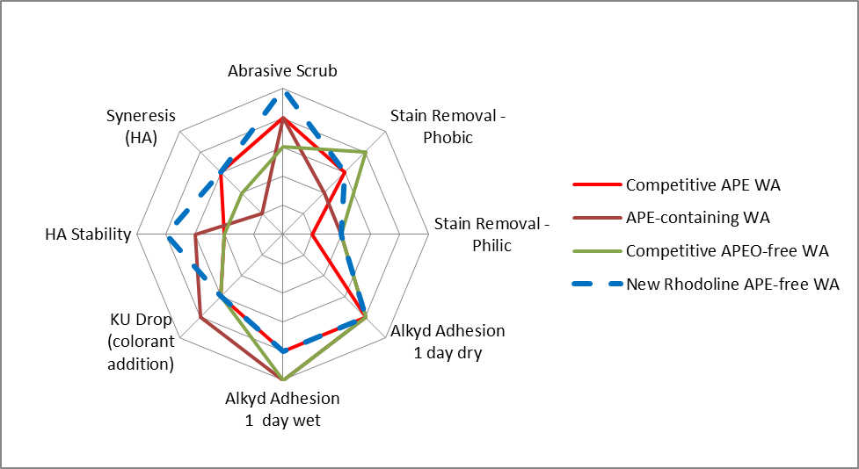
High Quality Flat - All Acrylic
50.5% PVC/33.5% VS; ~22g/L VOC; HEC/HEUR
Sheen, Flow, Sag, Opacity, DPUR, Color Float - all comparable
New RHODOLINE APEO-free WA Overall Performance is Better Than
APE-containing WA while maintaining Comparable Appearance Properties

Slide 13
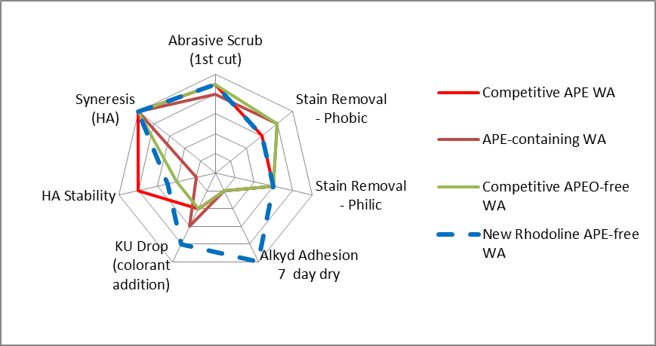
Premium Semigloss – All Acrylic
22.2% PVC/35% VS; ~20 g/L VOC; HEUR
Gloss, Flow, Sag, Opacity, DPUR, Color Float - all comparable
Note: All samples scrubbed > 2000 cycles for 50% abrasive scrub
New RHODOLINE APEO-free WA Overall Demonstrates Improved Adhesion and Colorant Stability in Semigloss Formulation compared to APE-containing WA

Slide 14
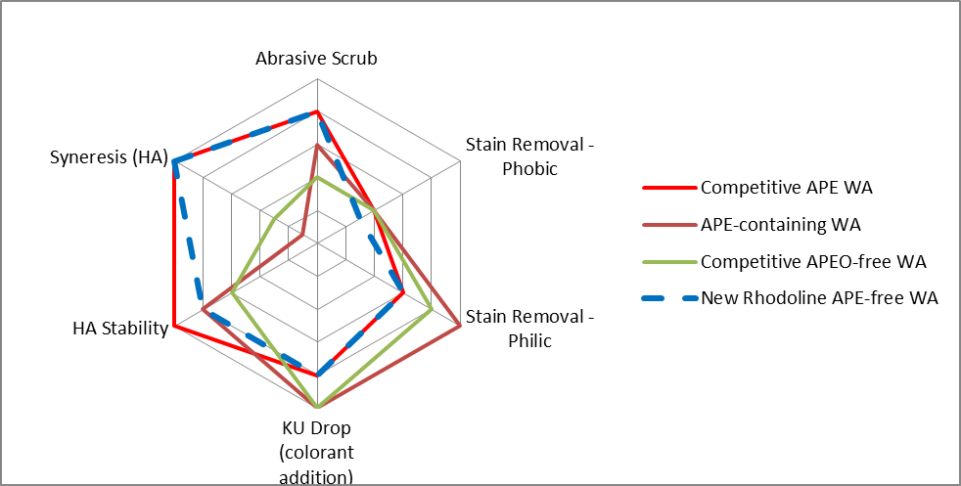
NAM: Economy Flat : PVA
70% PVC/28% VS; ~12 g/L VOC; HEC/HASE
Sheen, Flow, Sag, Opacity, DPUR, Color Float - all comparable
New RHODOLINE APEO-free WA has Comparable Performance to
APE-containing WA in High PVC PVA Formulation

Slide 15
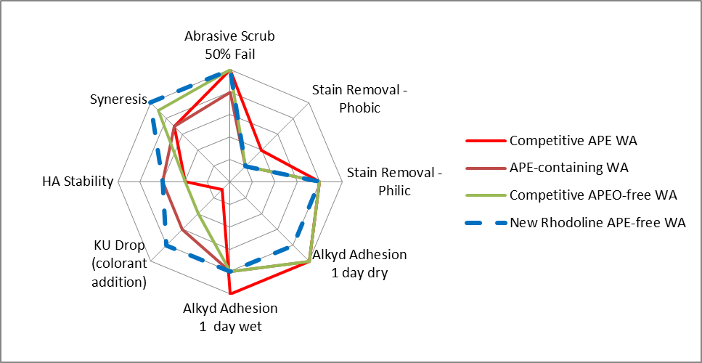
NAM: Economy Flat : Styrene/Acrylic
76% PVC/31% VS; ~33 g/L VOC; HEC/HASE
Sheen, Flow, Sag, Opacity, DPUR, Color Float - all comparable
New RHODOLINE APEO-free WA Demonstrates improved Stability and is
Comparable in other properties compared to
APE-containing WA in High PVC S/A Formulation

Slide 16
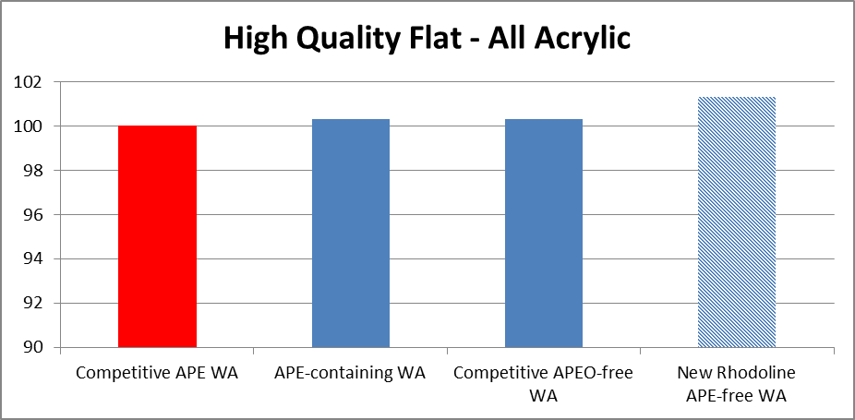
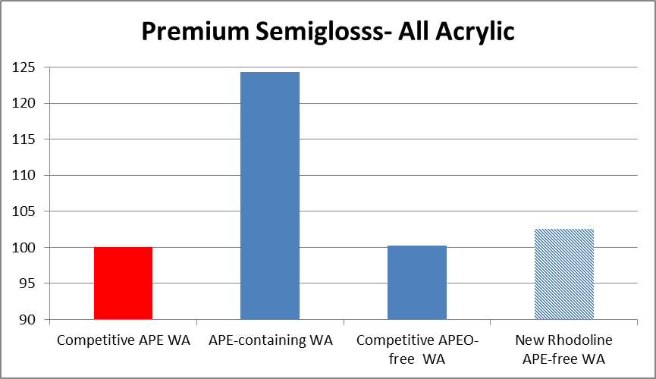
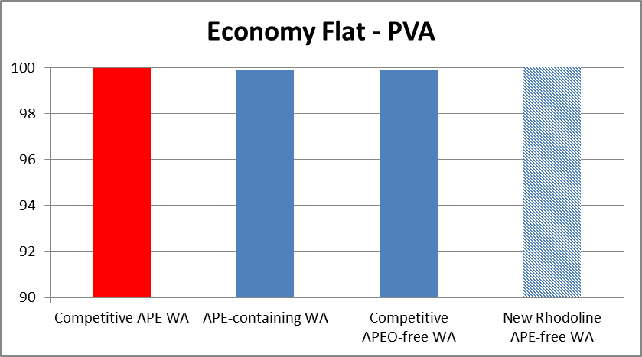
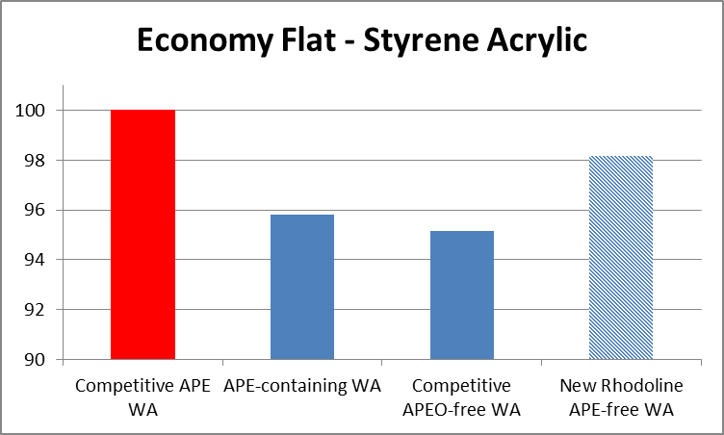
Tint Strength Performance
New RHODOLINE APEO-free WA has Comparable Performance to
Competitive APE-containing WA in High PVC PVA Formulation

Slide 17
New” Rhodoline® Wetting Agent Features
Summary
APE-free Nonionic Surfactant
Provides Excellent Wetting
Low Foaming
Fully compatible with all waterborne architectural binder technologies
Zero / Low VOC capable solution
New” Rhodoline® Wetting Agent Benefits
Offers “best in class” Tint Strength
Provides Good Viscosity and Shelf Life Stability
Excellent Choice to Replace APE-containing WA
- Comparable Appearance Properties in all Binder Chemistries/Formulations
- Equal or Improved Scrub Resistance
- Equal or Improved Alkyd Adhesion
Fully compatible with all waterborne architectural binder technologies
Zero / Low VOC capable solution

Slide 18
Thank you!
Linda Adamson - Technical Service Manager
Linda.adamson@solvay.com
215-285-6591
Committed to YOUR coatings success!
Material Safety Data Sheets (MSDS) are available by emailing us or contacting your sales representative. Always consult the appropriate MSDS before using any of our products.
Neither Solvay nor any of its affiliates makes any warranty, express or implied, including merchantability or fitness for use, or accepts any liability in connection with this product, related information or its use. Some applications of which Solvay’s products may be proposed to be used are regulated or restricted by applicable laws and regulations or by national or international standards and in some cases by Solvay’s recommendation, including applications of food/feed, water treatment, medical, pharmaceuticals, and personal care. family of biomaterials may be considered as candidates for use in implantable medical devices. The user alone must finally determine suitability of any information or products for any contemplated use in compliance with applicable law, the manner of use and whether any patents are infringed. The information and the products are for use by technically skilled persons at their own discretion and risk and does not relate to the use of this product in combination with any other substance or any other process. This is not a license under any patent or other proprietary right.
All trademarks and registered trademarks are property of the companies that comprise the Solvay Group or their respective owners.
© 2014 Solvay All rights reserved.
18

