Slide 1
Extender Functionality in Elastomeric Coatings
PNWSCT Coatings Fest, October 2018

Slide 2
Challenges of a Changing World

Slide 3
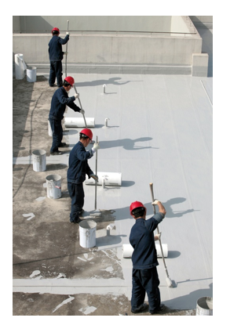
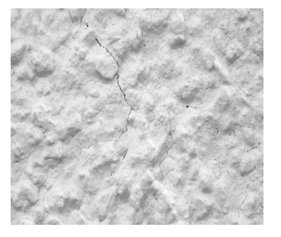
Elastomeric Coatings
Wall
Roof

Slide 4
Elastomeric Coating Formulation
INGREDIENTS | Pounds | Gallons
Water | 135.00 | 16.21
KTPP | 1.00 | 0.05
Dispersant | 8.00 | 0.91
Ammonium Hydroxide | 1.50 | 0.18
Surfactant | 2.00 | 0.24
Defoamer | 1.50 | 0.20
Preservative | 1.50 | 0.16
Titanium Dioxide | 100.00 | 3.00
Zinc Oxide | 20.00 | 0.43
Calcium Carbonate | 385.00 | 17.04
Biocide | 3.00 | 0.33
Emulsion | 530.00 | 58.89
Propylene Glycol | 18.00 | 2.08
Cellulosic Thickener | 4.00 | 0.48
Ammonium Hydroxide | 2.20 | 0.27
Defoamer | 2.00 | 0.27
Total | 1214.70 | 100.74
Density (lb/gal) | 12.06
Weight % Solids (%) | 65.29
Volume % Solids (%) | 49.89
PVC (additive included) (%) | 40.72
PVC (minus additive) (%) | 41.88
PVC / CPVC | 0.60
Can of Paint
Water
Pigment
Filler
Additive
Binder

Slide 5
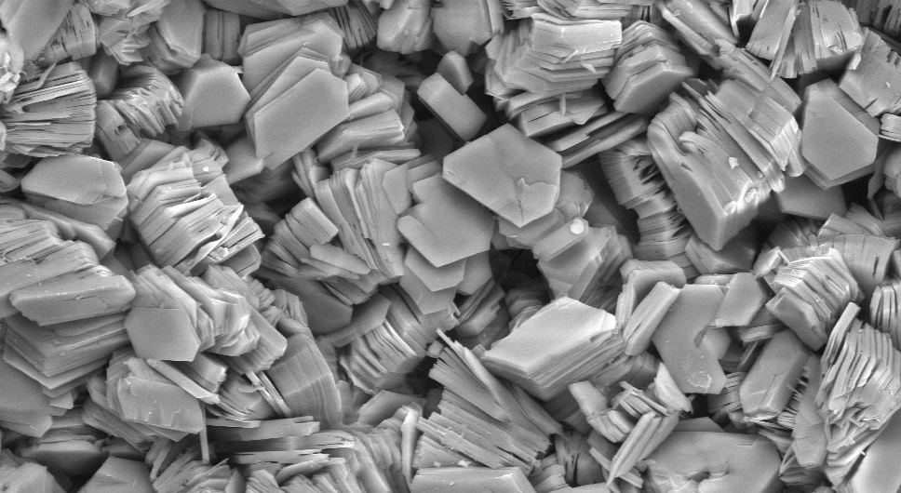
Particle Morphology
Nodular
Silica
Calcium Carbonate
Nepheline Syenite
Platy
Muscovite Mica
Talc
Kaolin
Acicular
Wollastonite
Image reproduced from the 'Images of Clay Archive' of the Mineralogical Society of Great Britain & Ireland and The Clay Minerals Society.

Slide 6
Particle Size
0 μm
35μm
Talc
Kaolin
Mica
Mica
Silica
Silica
Wollastionite
Titanium Dioxide
Wollastionite
Calcium Carbonate
Nepheline Syenite
Calcium Carbonate
Talc,
Calcium Carbonate,
Nepheline Syenite

Slide 7
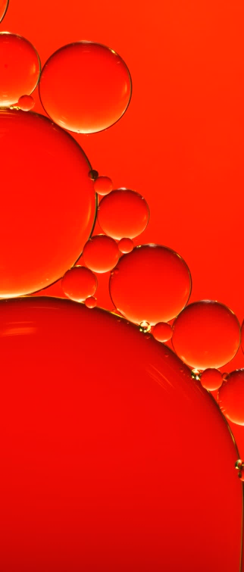
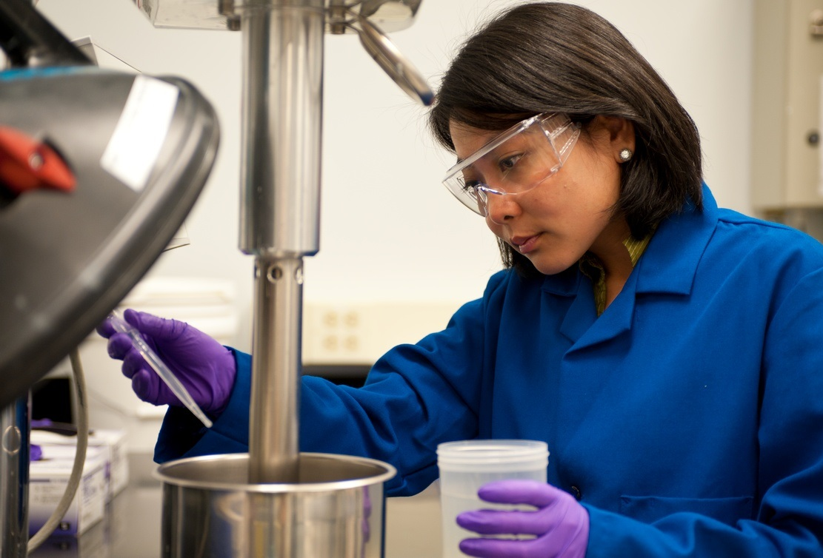
Variations in Oil Absorption Should be Considered

Slide 8
Critical Pigment Volume Concentration
Fraction of Critical = PVC/CPVC
PVC vs. Film Properties
CPVC
PVC = 100 * Vp/ (Vp + Vnvb)
V_{p} = pigment and filler volume
V_{nvb} = non-volatile binder volume
tensile
gloss
Performance Values
CPVC = 1/ 1+ (OA)(ρ)/93.5
OA = oil absorption (g linseed oil/g pigment)
ρ = density of pigment
93.5 = 100*density of linseed oil
permeability
PVC
CPVC
binder
pigment
voids

Slide 9
Variations on the Formula
Zinc Oxide
0.6 PVC/CPVC
0.6 PVC/CPVC
0.75 PVC/CPVC

Slide 10
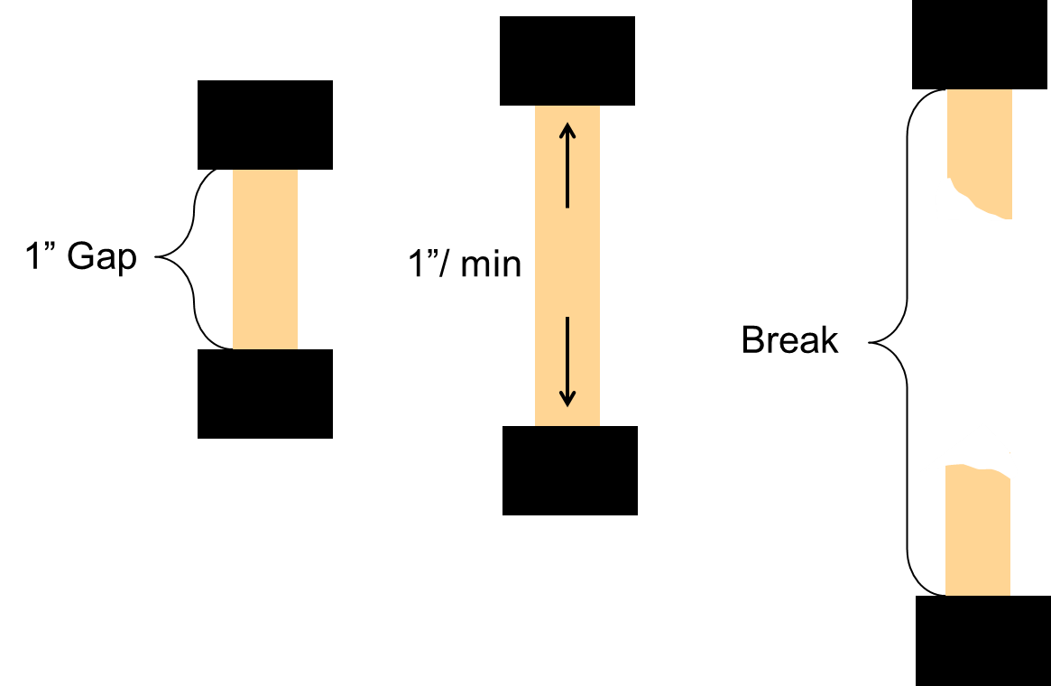
Method for Evaluating Tensile and Elongation
Instron Display:
Load vs. Displacement
Max Strain (Tensile)
Load (lbf)
Break %
(Elongation)
Displacement (Inches)

Slide 11
Film Thickness Matters
Tensile Strength
Percent Elongation

Slide 12
Tensile Strength is Impacted by Extender Particle Size
Tensile vs. Particle Size
0.6 PVC/CPVC, with Zinc Oxide

Slide 13
Tensile Strength is Impacted by Extender Particle Size
Tensile vs. Extender Type
0.6 PVC/CPVC, with Zinc Oxide

Slide 14
Tensile Strength is Impacted by Extender Particle Size
Tensile vs. Particle Size
Increasing PVC, Film Thickness
0.6 PVC/CPVC, with Zinc Oxide

Slide 15
Tensile Strength Increases with Increased PVC

Slide 16
Elongation Does Not Correlate Well with Extender Particle Size
Elongation vs. Particle Size
0.6 PVC/CPVC, with Zinc Oxide

Slide 17
Elongation Does Not Correlate Well with Extender Particle Size
Elongation vs. Particle Size
Increasing PVC, Film Thickness
0.6 PVC/CPVC, with Zinc Oxide

Slide 18
Elongation Decreases with Increased PVC

Slide 19
Tensile Strength Increases with the Inclusion of Zinc Oxide
Tensile vs. Extender Type

Slide 20
Elongation Decreases with the Inclusion of Zinc Oxide
Elongation vs. Extender Type

Slide 21
Tensile Strength Increases with Increasing Fraction of Critical
Tensile vs. Extender Type

Slide 22
Elongation Decreases with Increasing Fraction of Critical
Elongation vs. Extender Type

Slide 23
Balancing Tensile and Elongation
Tensile and Elongation vs. Extender Type
0.6 PVC/CPVC, with Zinc Oxide

Slide 24
Balancing Tensile and Elongation Removing Zinc Favors Elongation
Tensile and Elongation vs. Extender Type
0.6 PVC/CPVC, without Zinc Oxide

Slide 25
Balancing Tensile and Elongation Higher PVC/CPVC Restores Tensile Strength
Tensile and Elongation vs. Extender Type
0.75 PVC/CPVC, without Zinc Oxide

Slide 26
Weathering Dramatically Alters Tensile and Elongation
Tensile Strength
Elongation
0.6 PVC/CPVC, with Zinc Oxide
0.67 PVC/CPVC, without Zinc Oxide

Slide 27
Coalescent Usage Impacts the Balance Adding Texanol Reduces Tensile Strength
50 PVC

Slide 28
Coalescent Usage Impacts the Balance Adding Texanol Increases Elongation
50 PVC

Slide 29
Summary of Direct and Inverse Relationships
Tensile
Elongation
Coalescent Level
Plasticizer Level
Fraction of Critical
PVC
Zinc Oxide Level
Fraction of Critical
PVC
Zinc Oxide Level
Weathering
Particle Size

Slide 30
Method for Evaluating Two Cycle Recovery
Initial marks made 1 cm apart
Stretched 1” on Instron, 5 min
Removed and allowed to rest
Stretched 1” on Instron, 5 min
Removed and allowed to rest
Measured after 10 Minutes
Measured after 10 Minutes
Measured after 24 Hours
Measured after 24 Hours
{
1 cm
1st Cycle
2nd Cycle
% Recovery = Initial/Final

Slide 31
Recovery Improves with the Inclusion of Zinc Oxide
24 Hours After Second Pull

Slide 32
Recovery Improves with Decreasing Fraction of Critical
24 Hours After Second Pull

Slide 33
Variables Combine to Produce a Wide Range of Recovery Values
24 Hours After Second Pull

Slide 34
Recovery Shows Trends by Particle Morphology
Recovery vs. Extender Type
0.6 PVC/CPVC, with Zinc Oxide

Slide 35
Weathering Improves Recovery
Recovery
0.6 PVC/CPVC, with Zinc Oxide
0.67 PVC/CPVC, without Zinc Oxide

Slide 36
Summary of Direct and Inverse Relationships
Recovery
Zinc Oxide
Weathering
Nodular Extenders
Acicular Extenders
Platy Extenders
Fraction of Critical

Slide 37
Method for Evaluating Dirt Pick-up Resistance
10 mil DD
% Reflectance Retained = Final/Initial
7 Day Dry
Final Y-Reflectance Measurements
Iron Oxide Slurry Applied
Initial Y-Reflectance Measurements
30 Cycles on Scrub Machine
Allowed to dry
For Weathered DPUR, drawdowns are done on Aluminum Q-Panels and placed in the QUV for 3 Days UV/Condensation prior to testing.
Q
Sits for 2 Hours

Slide 38
Dirt Pick-up Resistance Improves with Decreasing Particle Size
DPUR vs. Extender Type
DPUR vs. Particle Size
0.6 PVC/CPVC, with Zinc Oxide

Slide 39
Dirt Pick-Up Resistance Worsens with the Inclusion of Zinc Oxide
DPUR vs. Extender Type

Slide 40
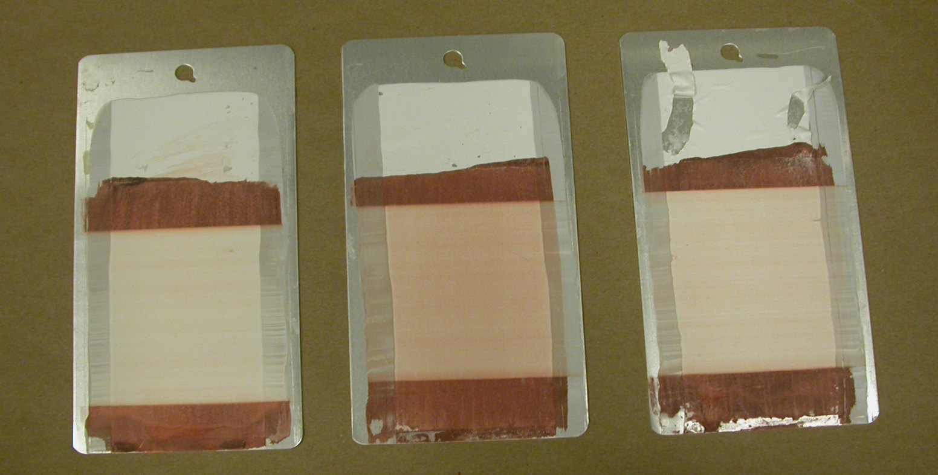
Weathered Dirt Pick-up Resistance is Impacted by Extender Type
0.7 μm
Calcium Carbonate
3.0 μm
Calcium Carbonate
1.2 μm
Talc
0.67 PVC/CPVC, without Zinc Oxide

Slide 41
Summary of Direct and Inverse Relationships
Dirt Pick-up Resistance
Particle Size
Zinc Oxide

Slide 42
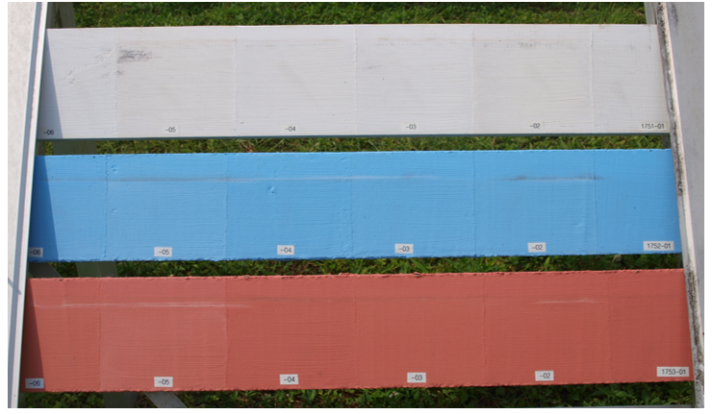
Exploring Further

Slide 43
Selecting an Extender Package: Variables to Consider
Stability
Settling
Elasticity
Barrier Properties
Rheology
Cost
Strength
Optical Properties
Water Resistance
Exterior Durability
Texture

Slide 44
Using Extenders to Target Desired Properties
Lower PVC/CPVC
Efflorescence Resistance
Elongation
Higher PVC/CPVC
Permeability
Recovery
Tensile Strength

Slide 45
Using Extenders to Target Desired Properties
Zinc
Recovery
Tensile Strength
No Zinc
Efflorescence Resistance
Elongation
Stability
DPUR

Slide 46
Using Extenders to Target Desired Properties
Calcium Carbonate
Lower Cost
Mica
Barrier Properties
Elongation
Tensile
Recovery

Slide 47
Thank you for your attention!

